Slide 1
Managed Competition in the Netherlands:
Providing Choice with Consumer Frictions
Johannes Spinnewijn (LSE)
October 23, 2020

Slide 2
Outline
Managed Competition: The Dutch Context
Regulation:
  Insurers’ Competition
  Provider Networks
  Consumer Choice
Application: Choice frictions and inequality
Conceptual: Value of offering choice in HI/SI

Slide 3
Dutch Context
Old System:
  Mandatory Social Health Insurance for lower income (2/3 of pop.)
    Provided by sickness funds
    Paid by mix of premium + payroll tax
    Gradual introduction of risk-adjusted capitation payments
  Voluntary Private Health Insurance
New System – Health Insurance Act 2006
  Mandated Basic Health Insurance for all
    Deductible choice - up to 875 EUR
    Supplemental coverage (dental, physio) – only 5% of expenses
    Limited provider network – chosen by less than 10%
  Sickness funds and private insurers compete on price
    Risk-adjustment transfers (~ US)

Slide 4
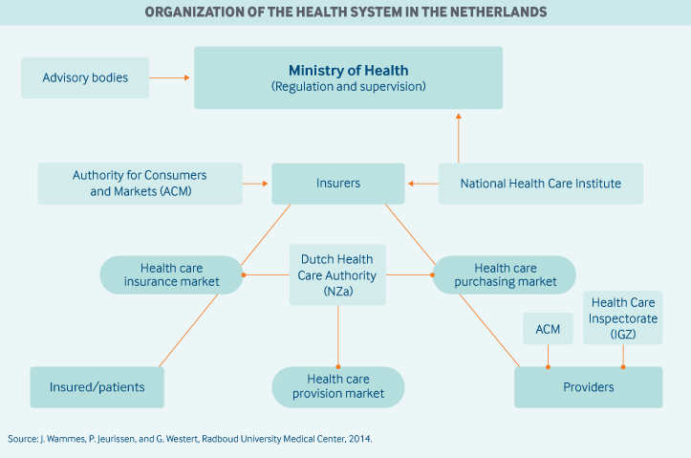
HIA 2006: Regulation

Slide 5
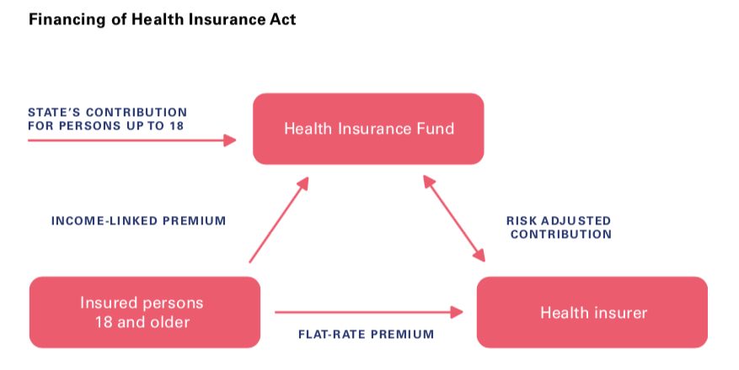
HIA 2006: Financing

Slide 6
Choice in Regulated Markets
Important focus over past several decades on offering choice in regulated markets / public policies
Choice introduces competition – lowering prices and improving quality
  “…to structure and adjust the market for competing health plans, to establish equitable rules, create price-elastic demand, and avoid uncompensated risk selection” [Enthoven - Health Affairs ‘93]
Choice allows consumers to match their heterogeneous preferences
  “…managed competition as a means to reform the U.S. health care system is compatible with Americans' preferences for pluralism, individual choice and responsibility, and universal coverage” [Enthoven - Health Affairs ‘93]

Slide 7
Choice in Regulated Markets
Predicated on consumers ability to make choices that reflect preferences
  Standard assumption of Revealed Preferences in economics
  Contrasts with growing literature on limitations in individual ability to make effective choices (e.g. Handel and Schwartzstein, 2019)
Regulation is strongly focused on supply-side inefficiencies
  E.g., lots of work on risk-adjustment algorithm
Too little on demand-side inefficiencies and its equity implications
  Choice quality is hard to measure
  Requires information on other observables for a representative sample

Slide 8
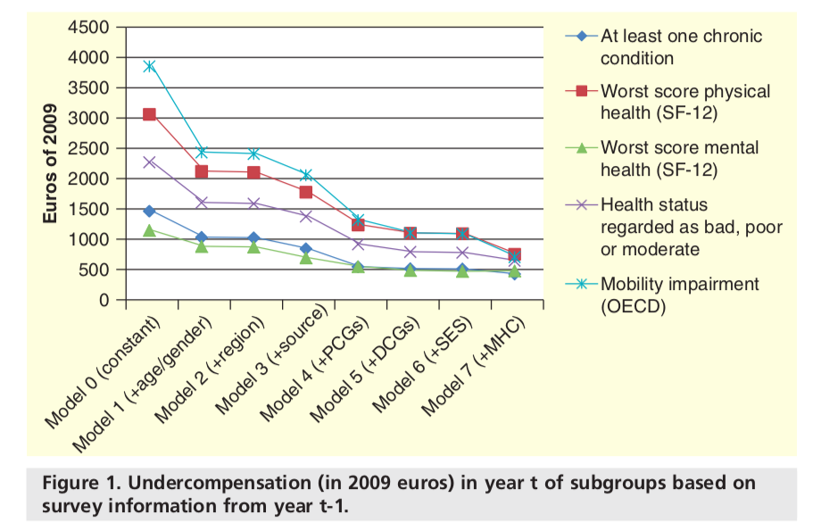
Risk-adjustment Transfers: Evaluation and Revisions
Source: various papers by Van Kleef and co-authors

Slide 9
Dutch Context (cont’d)
Fantastic data environment:
  population-wide, individually linked administrative registers
Wide range of data:
  Socio-economic: income, liquidity, debt, assets, education, field of study, occupation, employer, location, etc.
  Health: health expenditures and hospital diagnoses
  Insurance choices: insurer and deductible choice
  Linked surveys: e.g., health survey (500k participants)
Leverage rich data to analyse social determinants of quality of deductible choice (Handel et al. 2020)
  Minimum deductible of 375 EUR
  Add voluntary deductible (in 100 EUR increments) up to 875 EUR

Slide 10
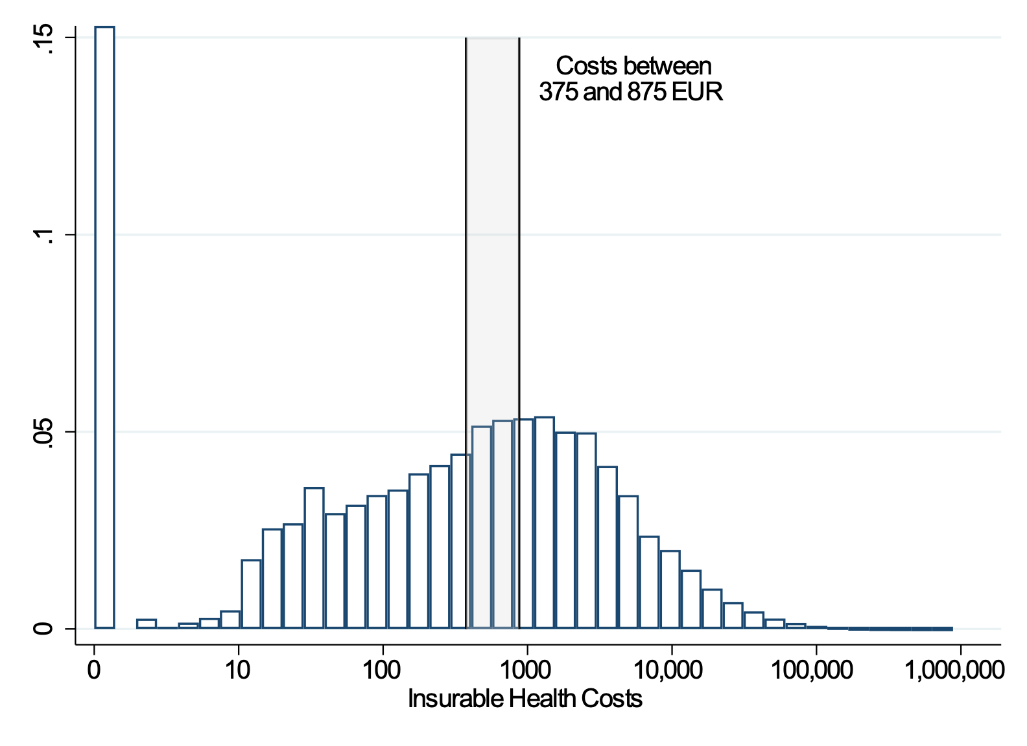
Health Care Costs
Breakdown by category

Slide 11
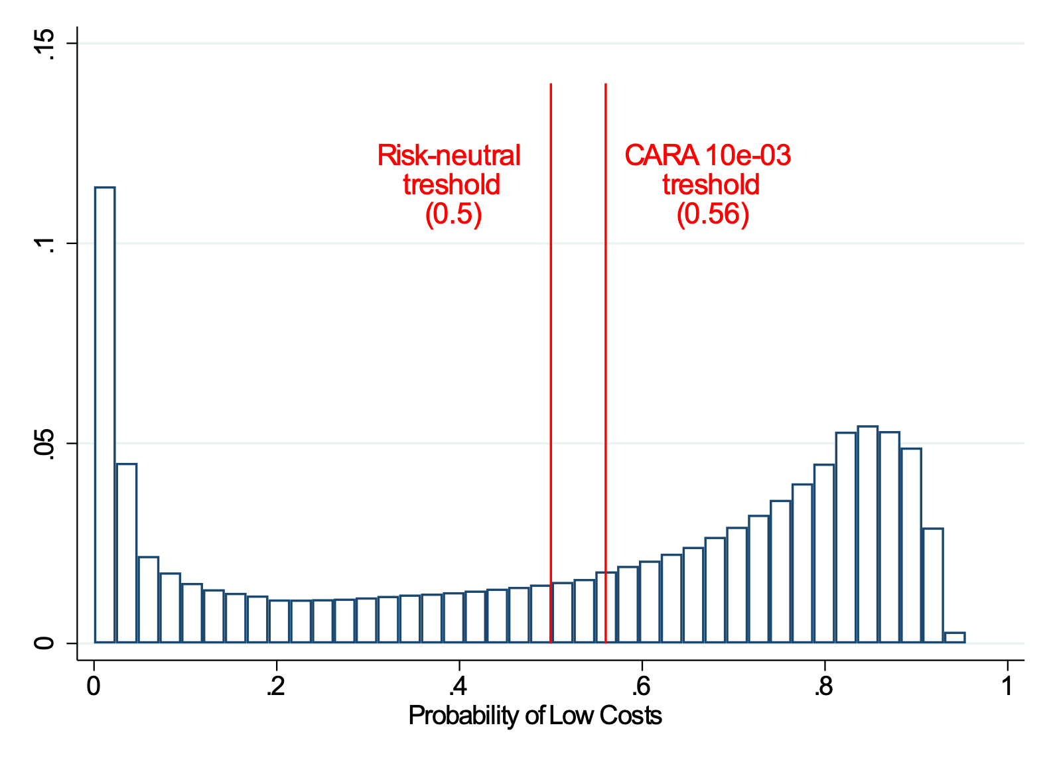
Predicted Risk & Optimal Frictionless Choice
0 deductible
500 deductible

Slide 12
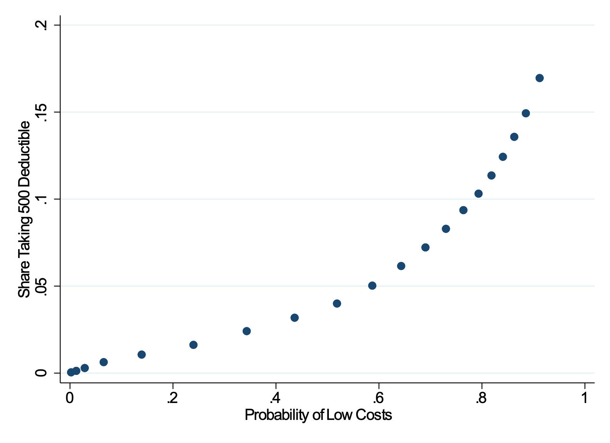
Deductible Choice and Health Risk
People move away from default deductible only if it is appropriate to do so…

Slide 13
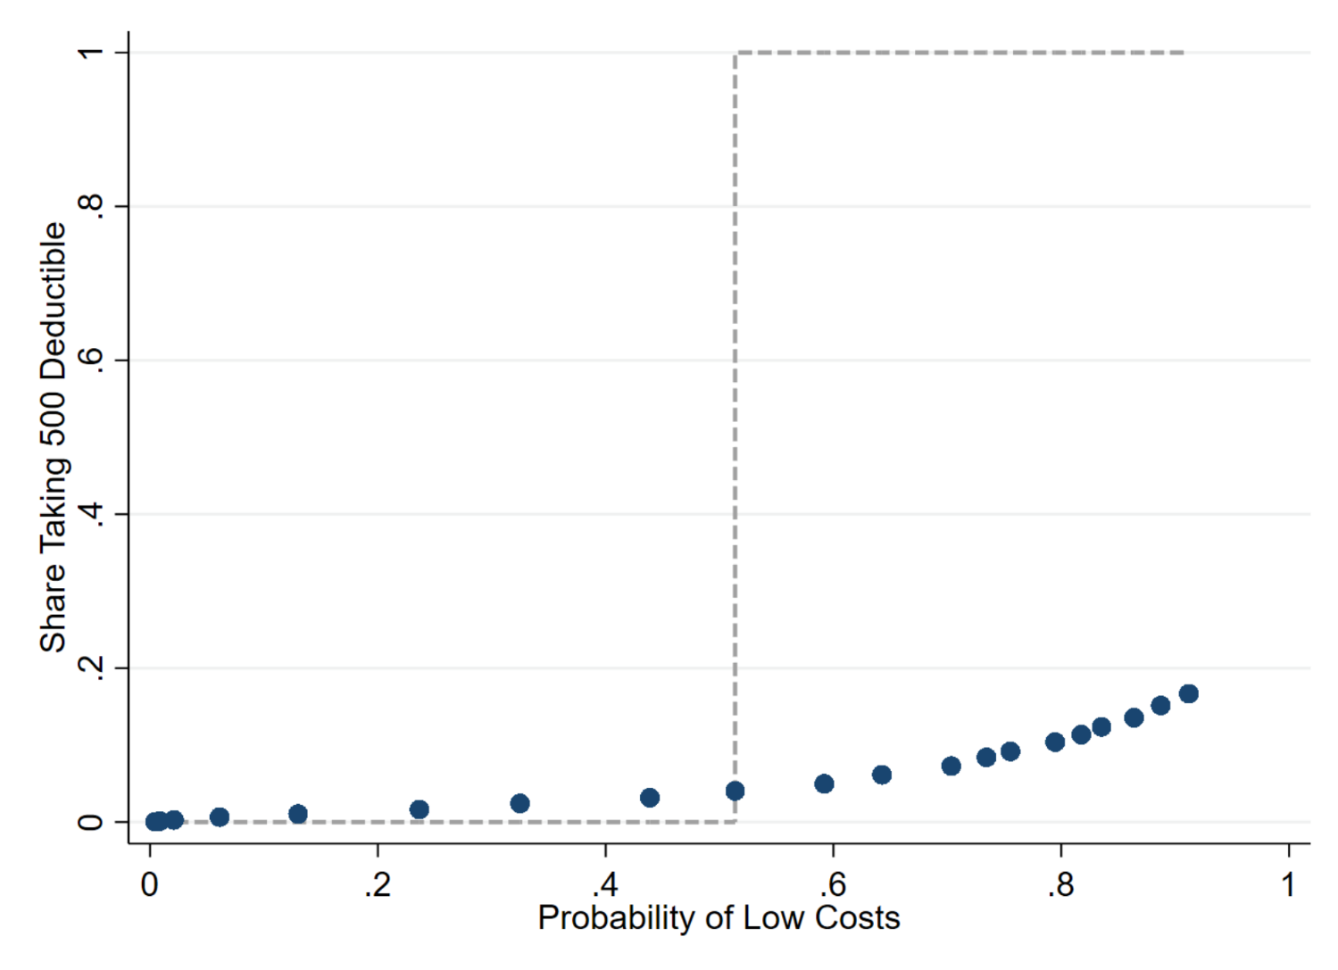
Deductible Choice and Health Risk
Take-up too low!
… but don’t do so nearly as much as is warranted for frictionless consumer

Slide 14
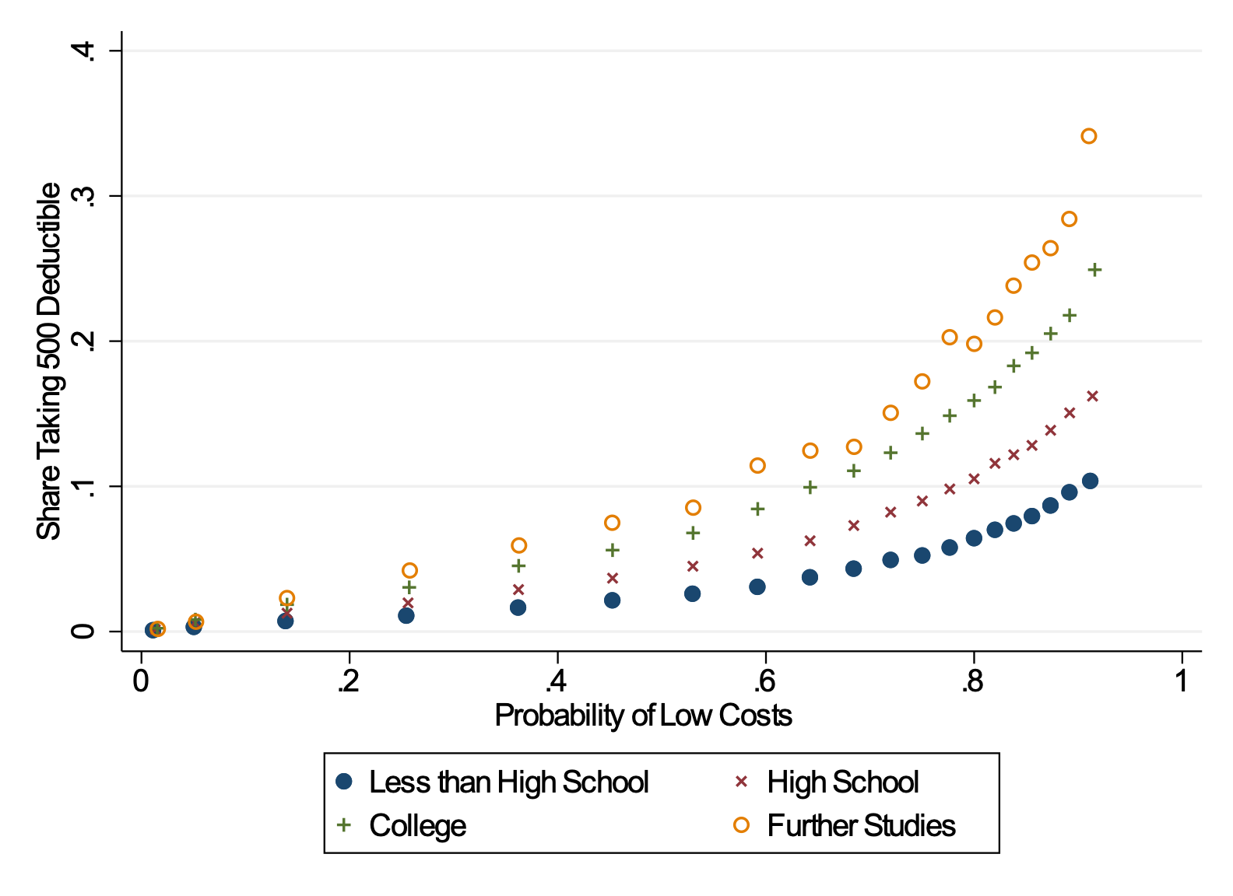
Deductible Take-up and Health, by Education

Slide 15
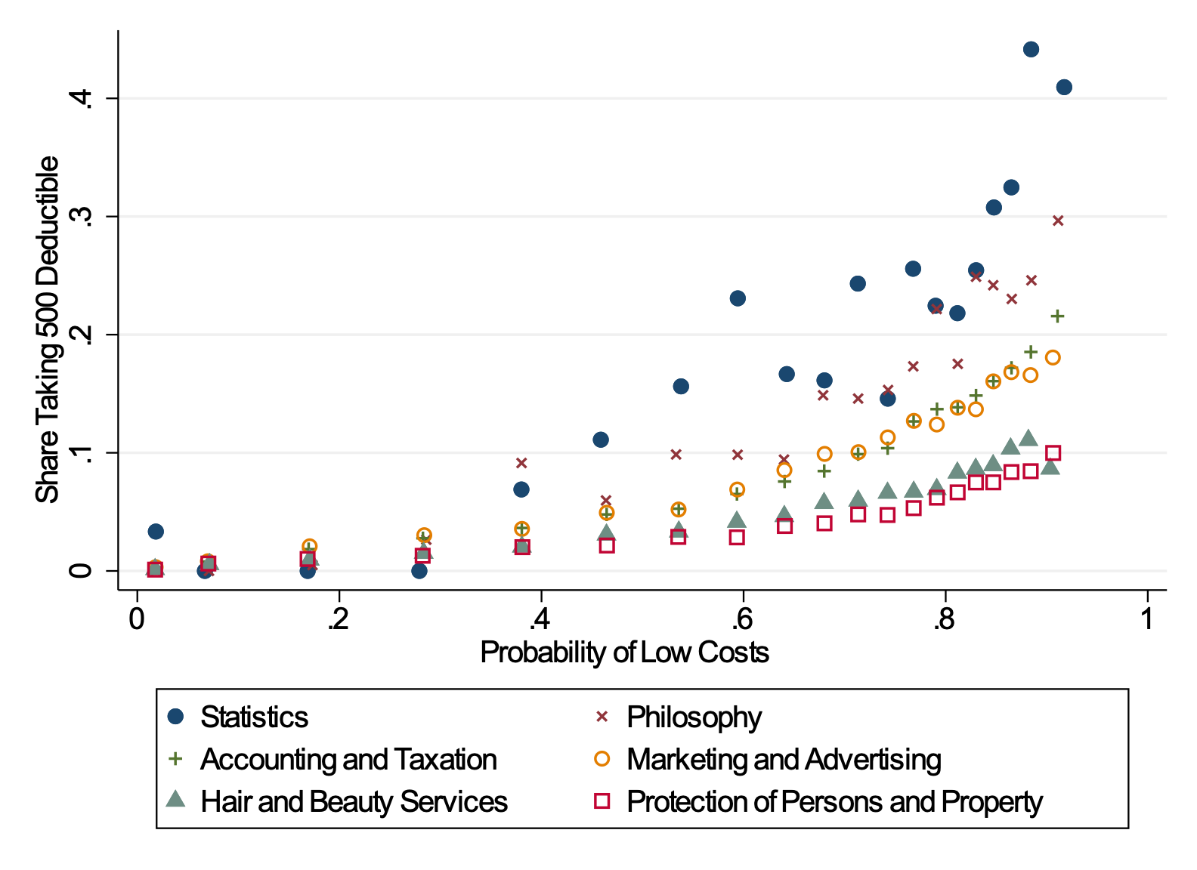
Deductible Take-up and Health, by Field of Study
Notes:
Baseline category are all other fields.
Currently we have not outputted the results on the ONET classification, or our personal classification as being quantitative or not. I would just mention that in the talk.

Slide 16
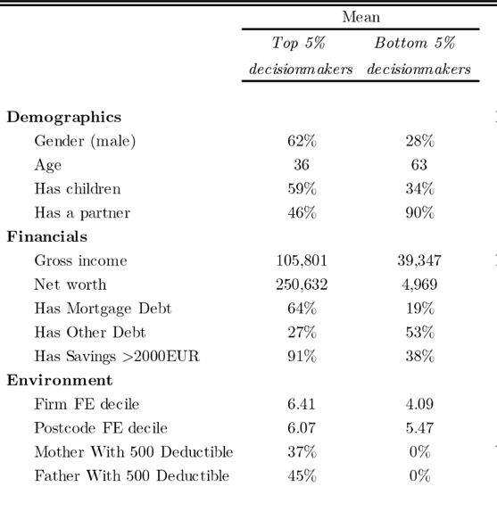
Best and Worst Decision-Makers
Worst Decision Makers
Earn on average 39K
Less than High school
Average age of 63
Studies hair & beauty. Works as security or cleaner.
Best Decision Makers
Earn on average 106K
College / advanced degree
Average age of 36
More likely to be men. Less likely to have children.
Studies statistics. Works in insurance.
Alternative version

Slide 17
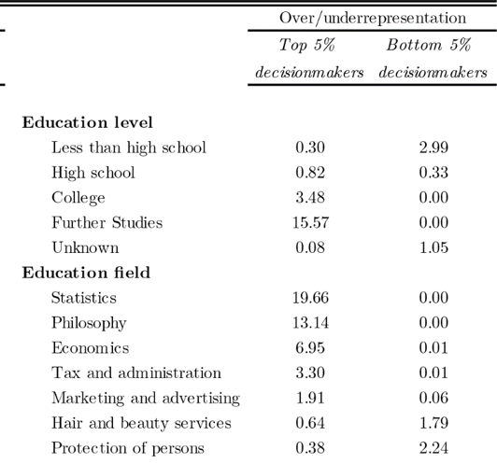
Best and Worst Decision-Makers
Worst Decision Makers
Earn on average 39K
Less than High school
Average age of 63
Studies hair & beauty. Works as security or cleaner.
Best Decision Makers
Earn on average 106K
College / advanced degree
Average age of 36
More likely to be men. Less likely to have children.
Studies statistics. Works in insurance.
Alternative version

Slide 18
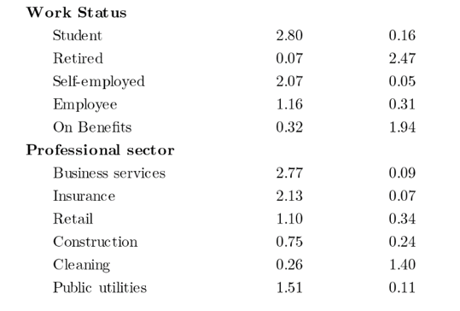
Best and Worst Decision-Makers
Worst Decision Makers
Earn on average 39K
Less than High school
Average age of 63
Studies hair & beauty. Works as security or cleaner.
Best Decision Makers
Earn on average 106K
College / advanced degree
Average age of 36
More likely to be men. Less likely to have children.
Studies statistics. Works in insurance.
Alternative version

Slide 19
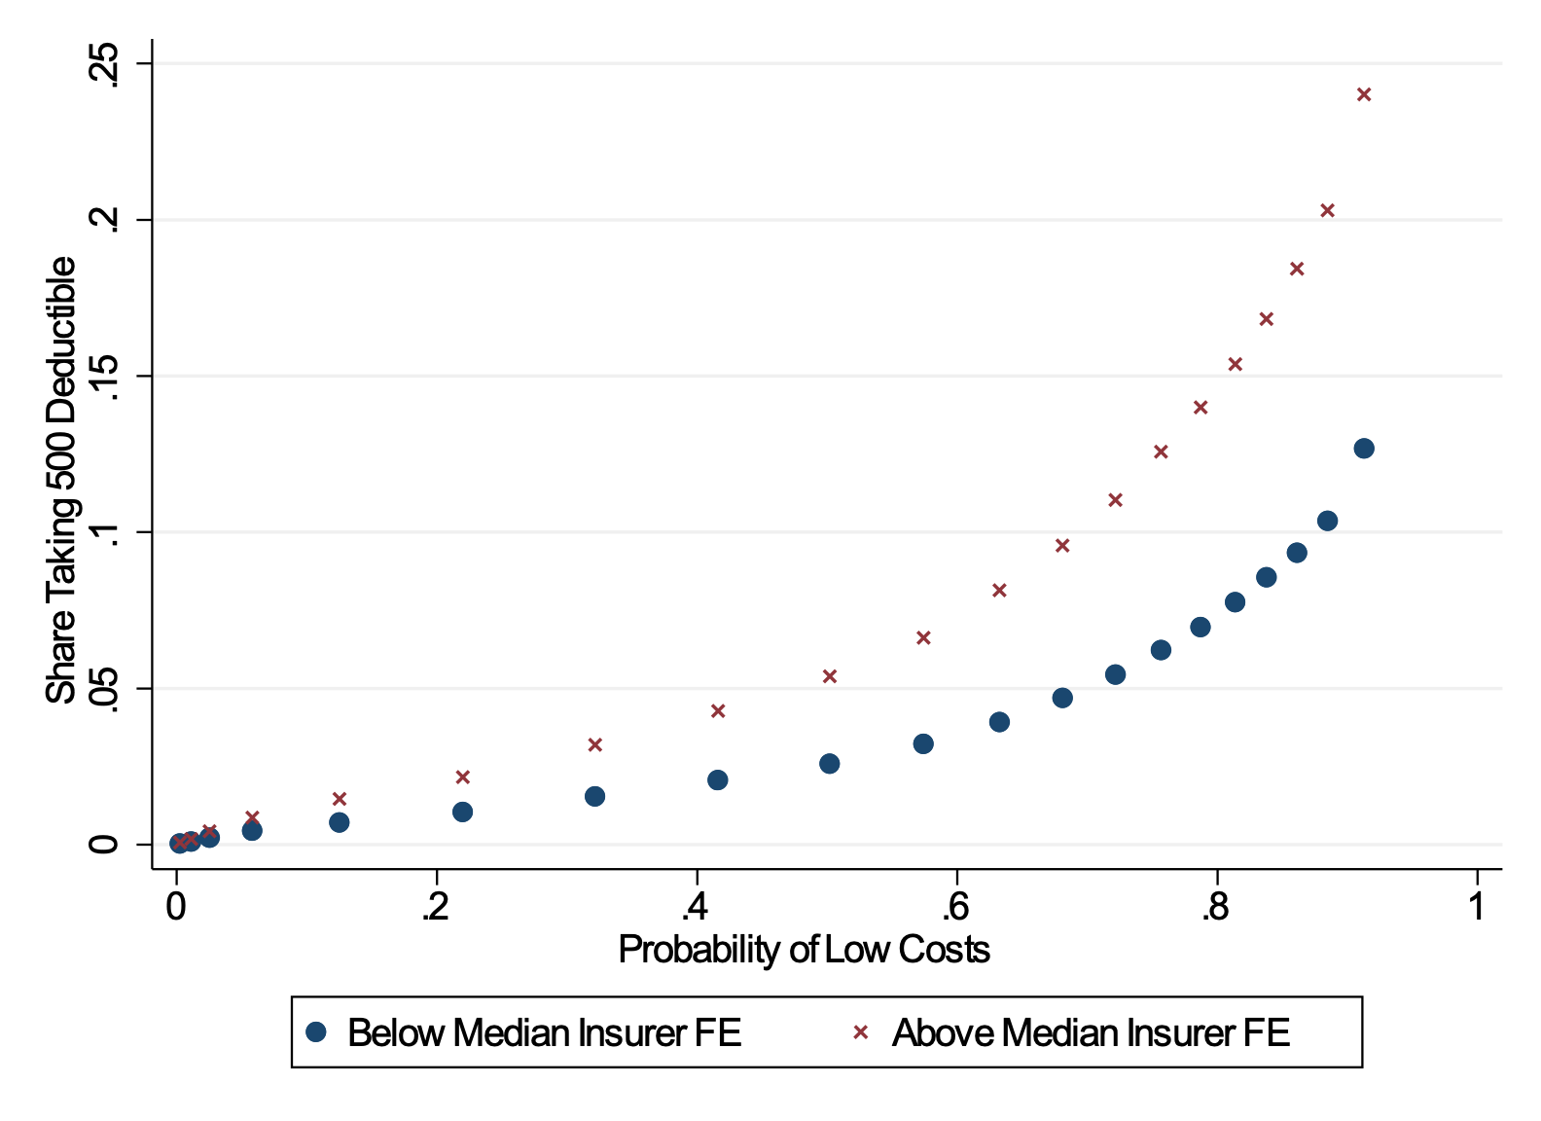
Deductible Take-up and Health, by Insurer

Slide 20
Takeaway on Value of Deductible Choice
Deductible option in the Netherlands provides limited value
  This ignores government’s implementation costs and individual decision costs (plausibly quite large)
Gains from choice are unequally distributed
  High income/SES are healthier
  High income/SES make better decisions
Should we reconsider offering (vertical) choice? How much coverage should we provide?

Slide 21
Choice in Social Insurance: A Comparison
Source: Hendren et al. (2020)

Slide 22
Choice in Social Insurance: What is the Value?
How much coverage to provide in universal system?
E(v’(b)) = E(c’(b))
Should we provide option to get more coverage?
E(v’(b) | opt ) - E(v’(b)) > E(c’(b) | opt ) - E(c’(b))
Heterogeneity in preferences is key. Value of offering choice decreases with:
  Selection on risk
  Selection on moral hazard
  Selection on frictions

Slide 23
Evidence on Micro-foundations of Choice Value
Source: Hendren et al. (2020)

Slide 24
Choice in Social Insurance: Policy Implications
Evaluate whether choice can be valuable
  Not just from an efficiency, but also from an equity perspective
Use prices and regulation to overcome limits to choice
  Not just supply-side frictions, also consumer-side frictions
Eliminating consumer-side frictions (e.g., choice aids) can increase value and improve equity

Slide 25
Thanks!

Slide 26
Appendix

Slide 27
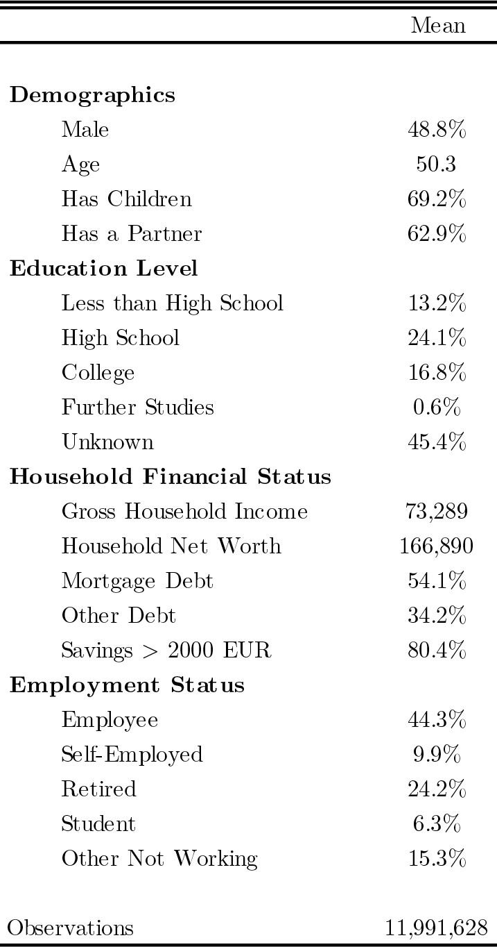
Context: Health Insurance in Netherlands
Managed competition insurance market with heavy public regulation
Regulated choice includes option to elect higher deductibles from 375 – 875 €
Great environment to assess choice quality w/ simple choice for entire country.
Notes:
Purpose is to show off our rich data right away
Make sure to mention here that 375 is “default” choice and baseline deductible
Insurers differ on range of dimensions, but differentiation is narrow and all insurers offer same deductible choices, pure financial differentiation

Slide 28
Context: Health Insurance in Netherlands
Linked individual-level data for entire country:
-- Deductible choice
-- Detailed health data
+
-- Education and Job
-- Income / Debt / Wealth
-- Work peers
-- Location peers
-- Family members
Notes:
Purpose is to show off our rich data right away
Make sure to mention here that 375 is “default” choice and baseline deductible

Slide 29
Choice Model
Simplify choice environment to:
Default deductible of 375 EUR
Or
Voluntary deductible of 875 EUR
(at 250 EUR premium reduction)
Simplified decision rule for risk-neutral, frictionless decision-maker, :
Take extra 500 EUR deductible iff Prob(x < 375) > 0.5
Straightforward to assess optimal decision rule as a function of different underlying expected utility preferences:
    CARA 10⁻⁵ : 0.5006; CARA 10⁻⁴ : 0.506; CARA 10⁻³ : 0.56
    liquidity constraints as empirically equivalent to higher levels of risk aversion (Chetty and Szeidl, 2015)
Notes:
NOTE: Optimal decision here refers to optimal FRICTIONLESS Decision
PRESENT EVIDENCE ON PREMIUM NARROWLY CENTERED AT 250
MAKE CASE THAT COMPULSORY DEDUCTIBLE IS DEFAULT FOR ALL INSURERS

Slide 30
Risk Model
Prediction: probability that individual has costs [0,375]
  Ensemble learner for binary classification, combining random forest, boosted regression trees, and LASSO
  Models tuned, trained, and calibrated on subsets of training sample (1M observations)
Approx. 50 individual-specific predictors:
  Past health spending: per health category, (t-2, t-1)
  Demographics: gender, age, work status, education level, income
Results and plots use hold-out sample of approx. 11.6M
Variable importance in prediction
Notes:
Can also link to (i) model fit (ii) variable importance (iii) seven categories

Slide 31
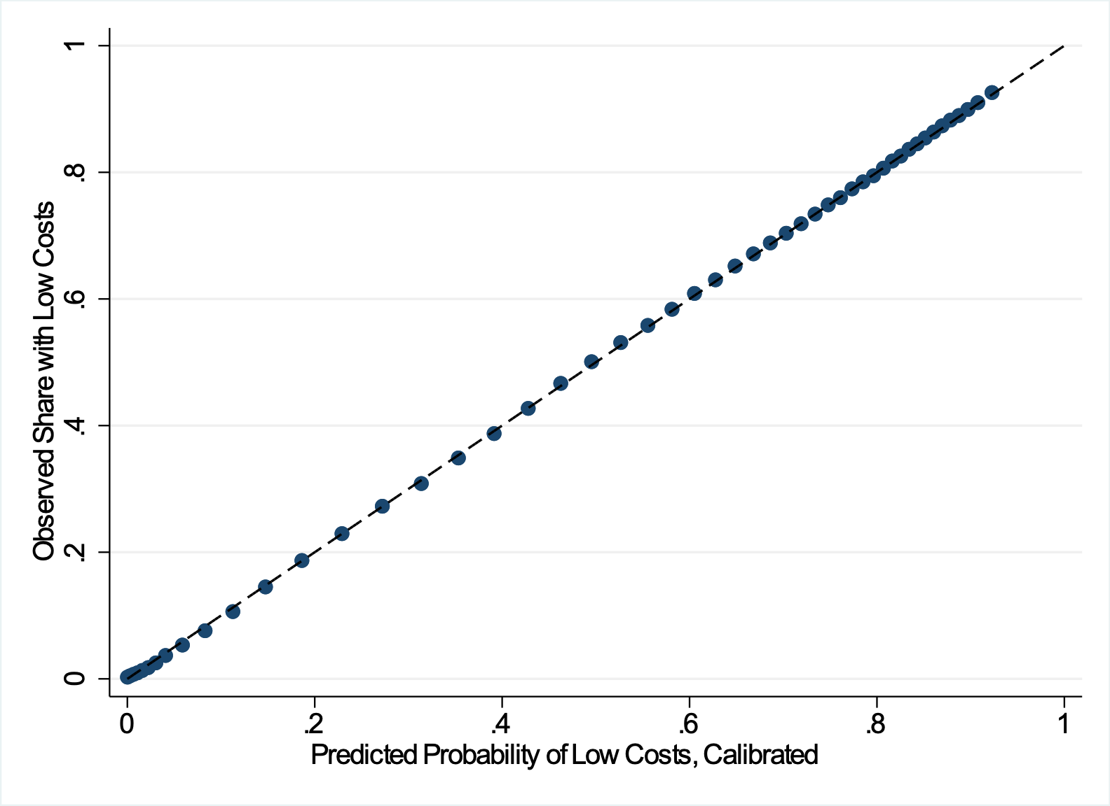
Predicted vs. Realized Health Risk

Slide 32
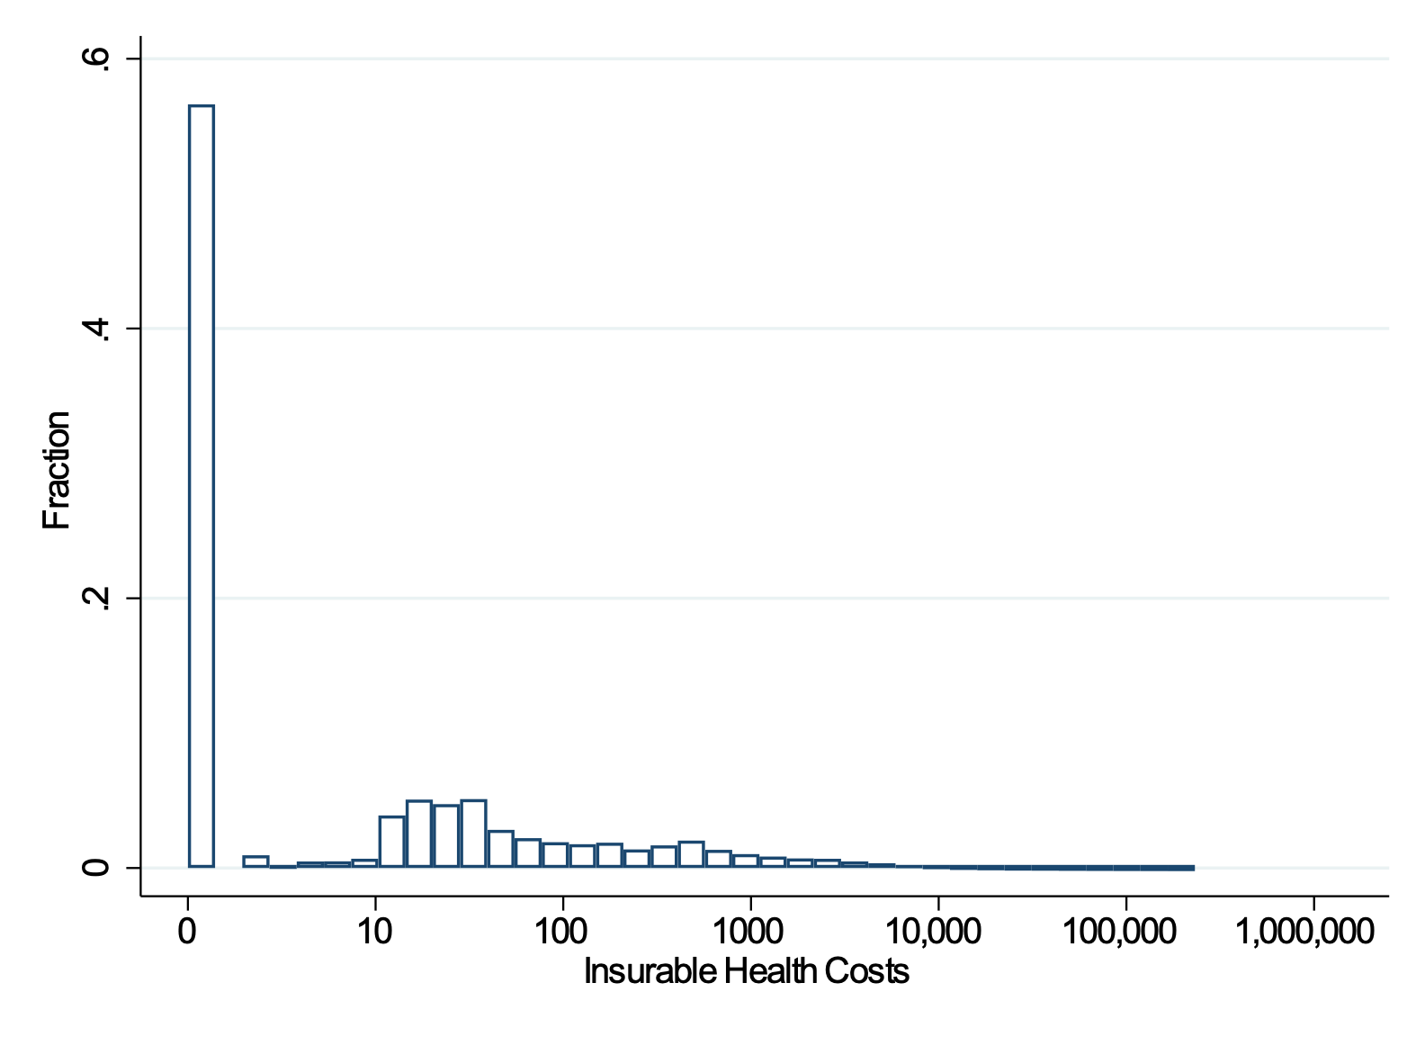
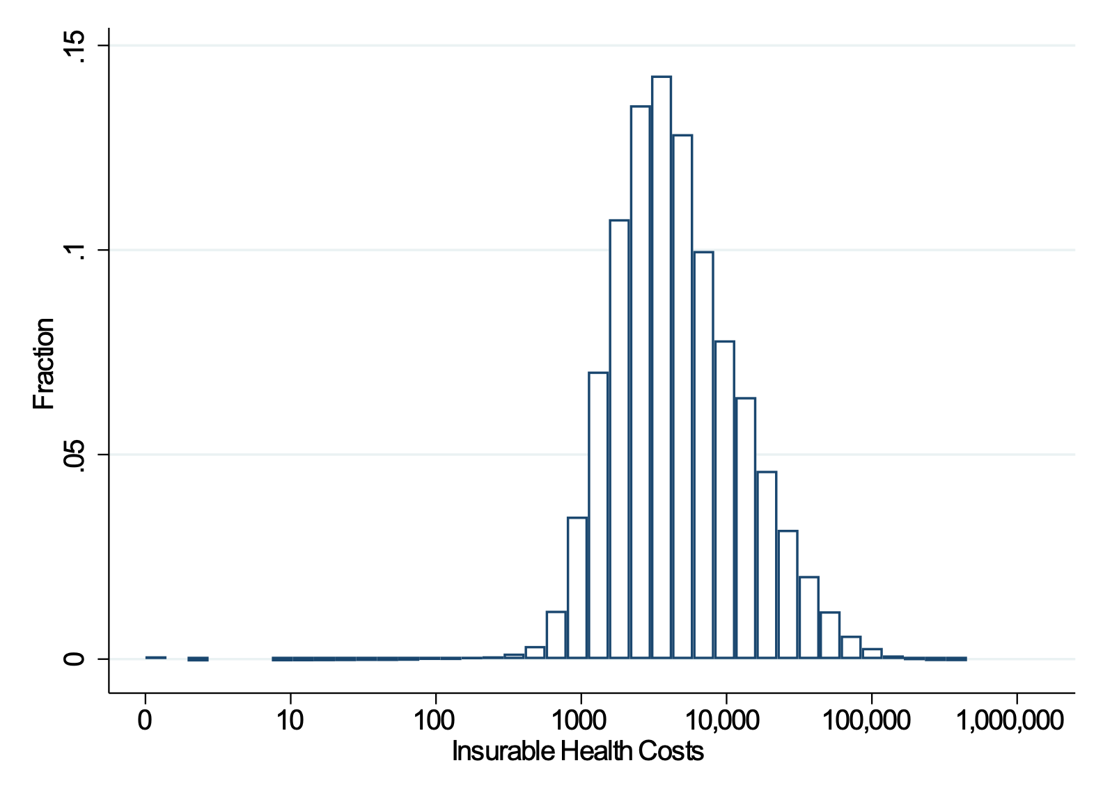
Ex-Post Realization of Costs
Top 5% Predicted Health
Bottom 5% Predicted Health

Slide 33
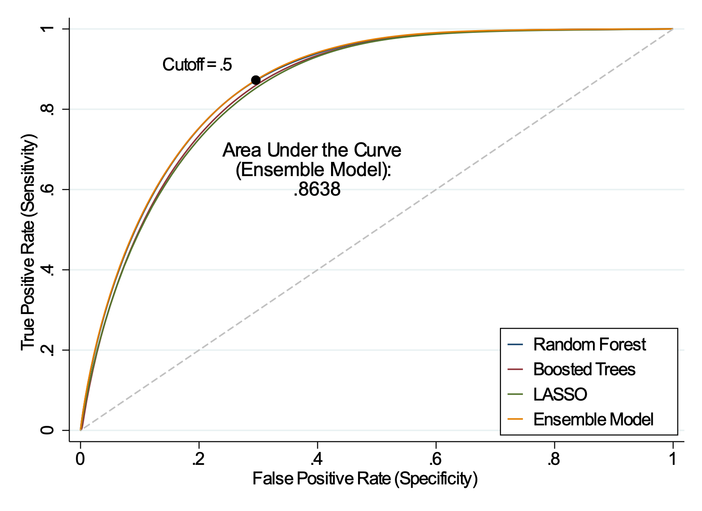
ROC Curve for Cost Prediction Models

Slide 34
Social Determinants: Evidence
We investigate relationship between social factors and deductible choice:
Human Capital: Education level, type of degree, profession
Financial Capital: Income, debt, savings, liquidity
Environmental Effects: Peers at firm, at location, parents’ choices
For socio-economic factors we present
    unconditional correlations with deductible choice as function of health risk
    corresponding regression estimates, controlling for range of other factors

Slide 35
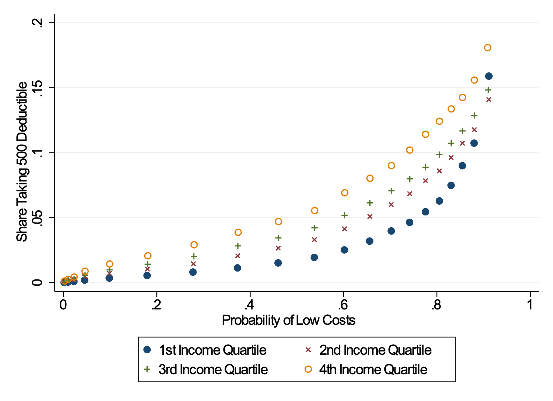
Deductible Take-up and Health, by Income
Notes:
Graph excludes the students, self-employed, people under social minimum. Regression specification still has included the students, self-employed, people under social minimum… That’s likely why slope of quartile 2 is lower.

Slide 36
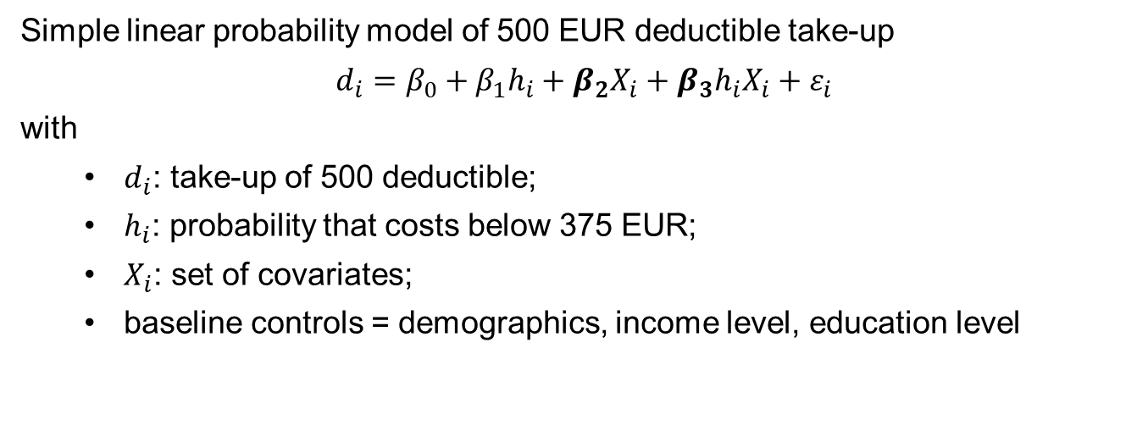
Social Determinants: Regression Framework
Simple linear probability model of 500 EUR deductible take-up
$$d_{i}=β_{0}+β_{1}h_{i}+β_{2}X_{i}+{β_{3}h_{i}X_{i}+ε}_{i}$$
with
  $d_{i}$: take-up of 500 deductible;
  $h_{i}$: probability that costs below 375 EUR;
  $X_{i}$: set of covariates;
  baseline controls = demographics, income level, education level
Notes:
Note: all regressions have as baseline covariates education level, 4 age dummies, gender, have children, self-employed

Slide 37
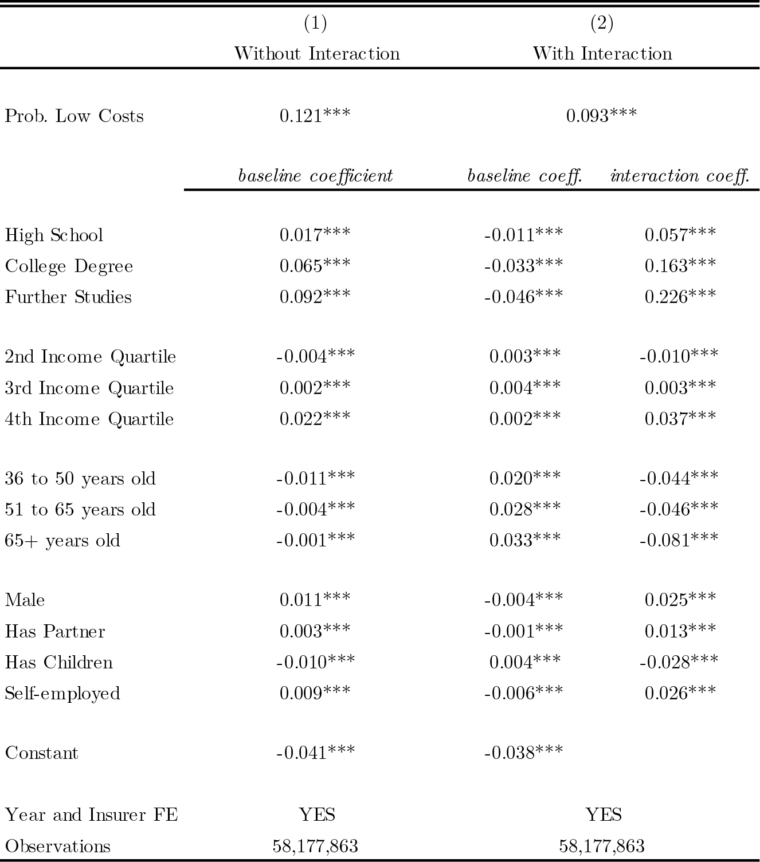

Slide 38
Field of Study
Unconditional Results
Regression Results
 | Intercept | Slope
Statistics | -2.8%*** | 19.8%***
Philosophy | -0.1%*** | 2.9%***
Accounting | -0.3%*** | 2.3%***
Marketing | 0.0%*** | -0.3%***
Hair and Beauty | 0.6%*** | -3.4%***
Protection of Persons | 0.7%*** | -6.5%***
Notes:
Baseline category are all other fields.
Currently we have not outputted the results on the ONET classification, or our personal classification as being quantitative or not. I would just mention that in the talk.

Slide 39
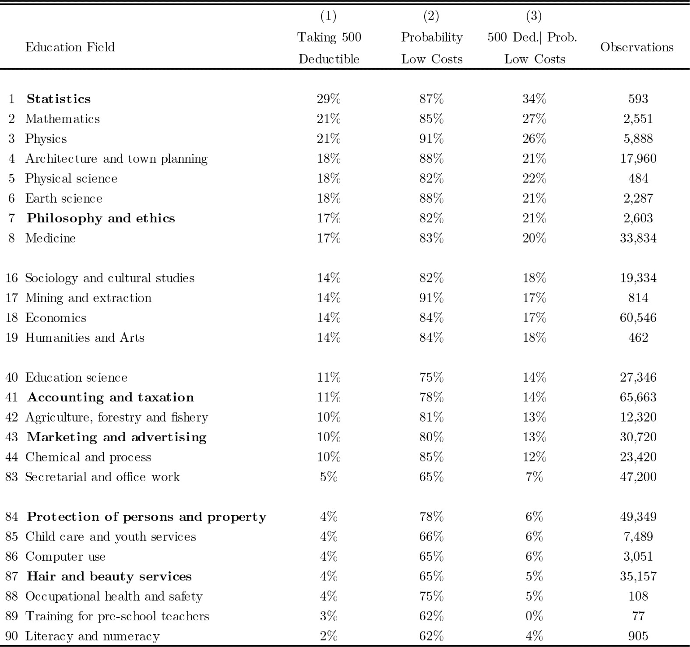
Notes:
This is at the sector level. Baseline category is all other sectors.

Slide 40
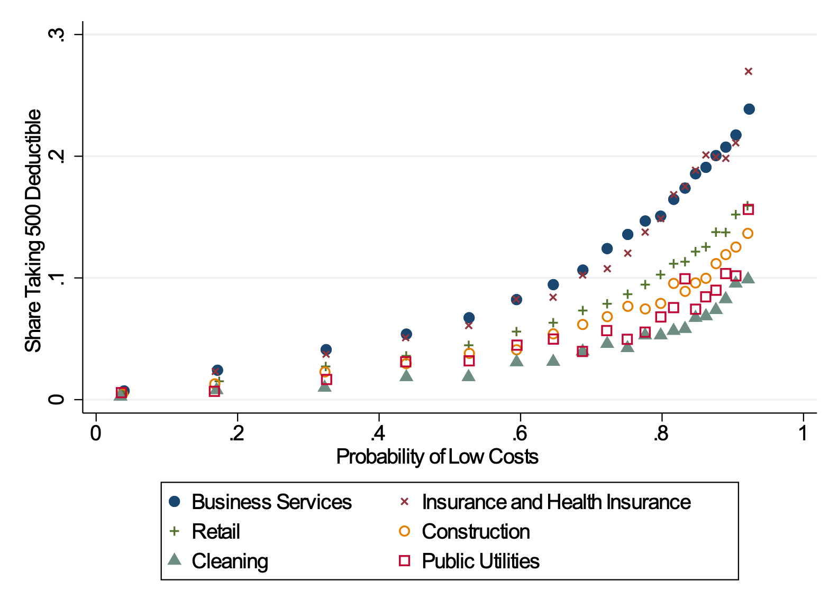
Professional Sector
Unconditional Results
Regression Results
 | Intercept | Slope
Business Services | -1.1%*** | 4.1%***
Insurance / Health Ins. | -2.3%*** | 7.3%***
Retail | -0.2%*** | -0.1%***
Construction | -0.0%*** | -1.8%***
Cleaning | 0.5%*** | -0.8%***
Public Utilities | 0.3%*** | -3.2%***
Notes:
This is at the sector level. Baseline category is all other sectors.

Slide 41
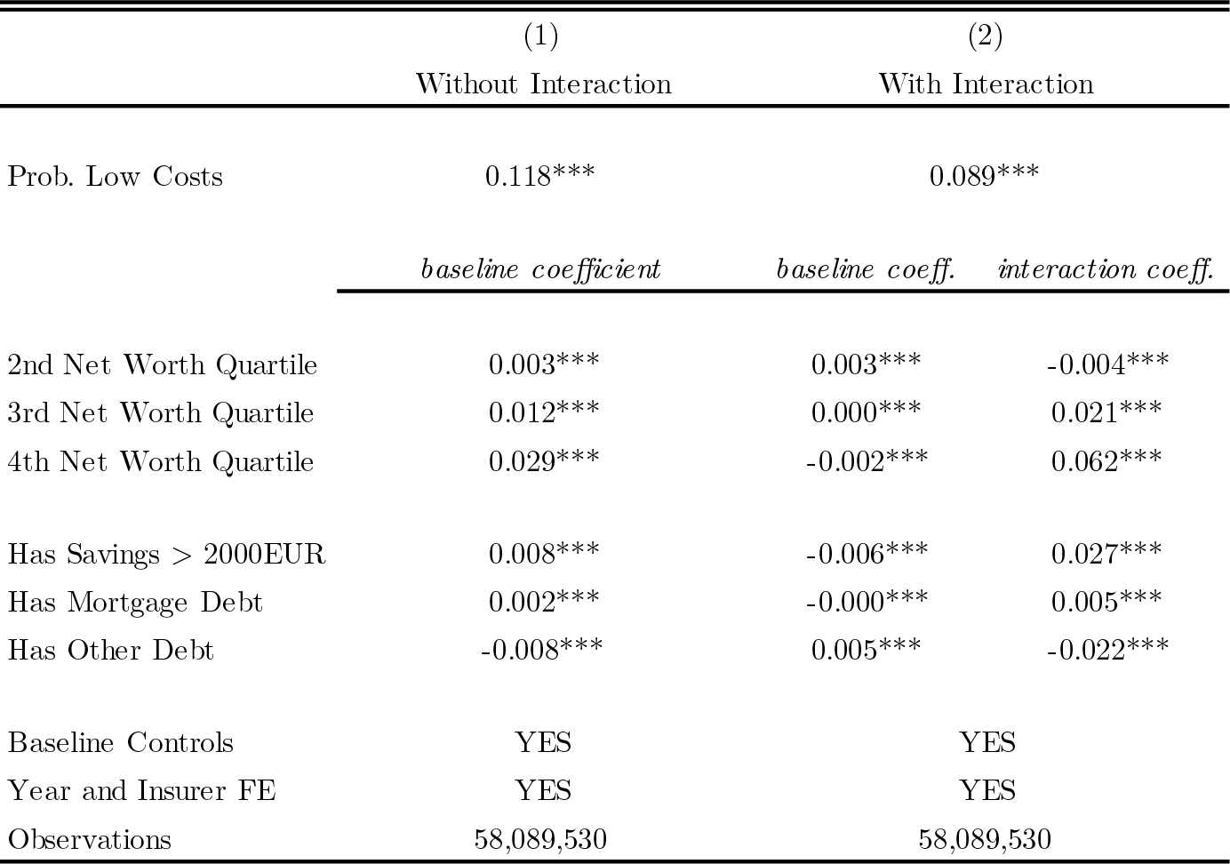
Personal Finance

Slide 42
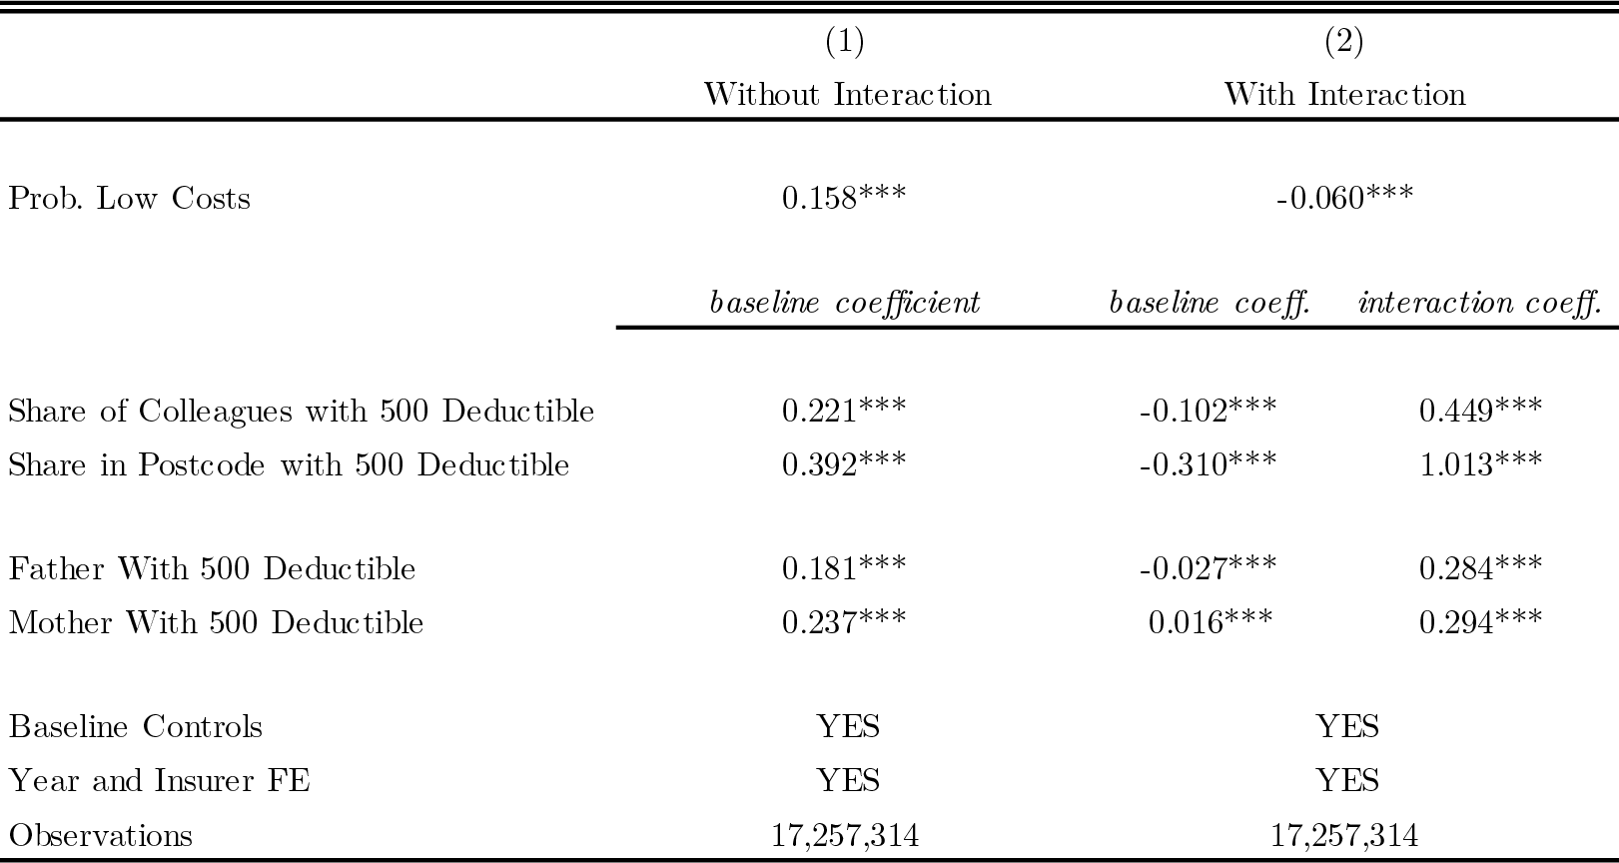
Peer Effects: Correlations
Interesting as correlation, but want to go beyond and get causal interpretation

Slide 43
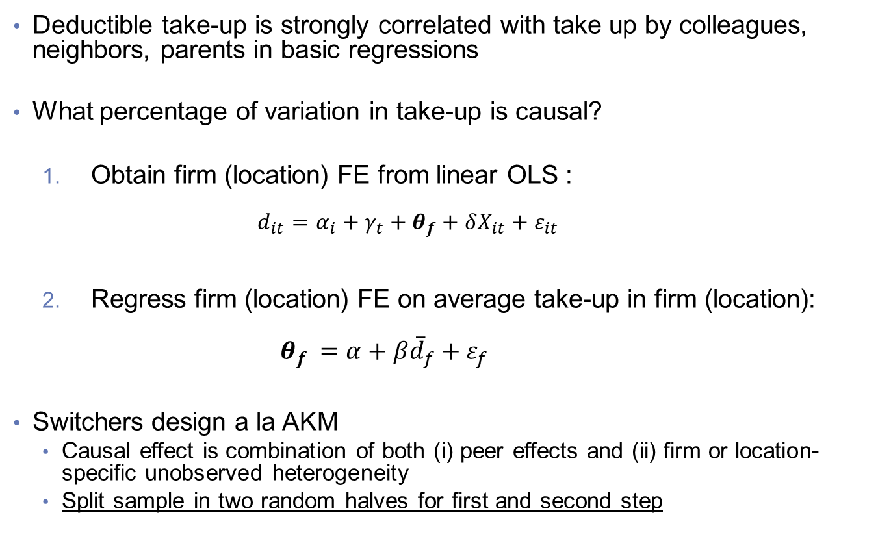
Peer Effects: Switchers Design
Deductible take-up is strongly correlated with take up by colleagues, neighbors, parents in basic regressions
What percentage of variation in take-up is causal?
  Obtain firm (location) FE from linear OLS :
  $d_{it}=α_{i}+{γ_{t}+θ}_{f}+δX_{it}+ε_{it}$
  Regress firm (location) FE on average take-up in firm (location):
  ${ θ}_{f }=α+β{\overline{d}}_{f}+ε_{f}$
Switchers design a la AKM
  Causal effect is combination of both (i) peer effects and (ii) firm or location-specific unobserved heterogeneity
  Split sample in two random halves for first and second step
Notes:
There was an error with how we defined take-up share. This is now fixed (and which is why results are now correct and more stable). Graph only include firms n>=100. We have not worried about connected set yet, we can do that later.

Slide 44
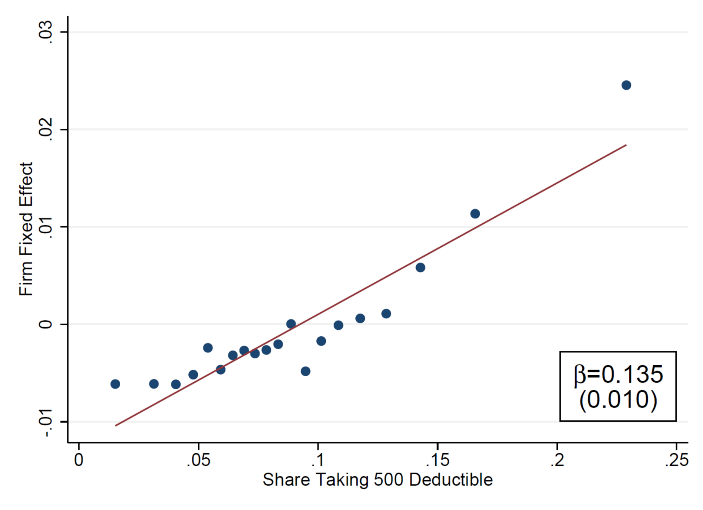
Peer Effects: Colleagues
Notes:
There was an error with how we defined take-up share. This is now fixed (and which is why results are now correct and more stable). Graph only include firms n>=100. We have not worried about connected set yet, we can do that later.

Slide 45
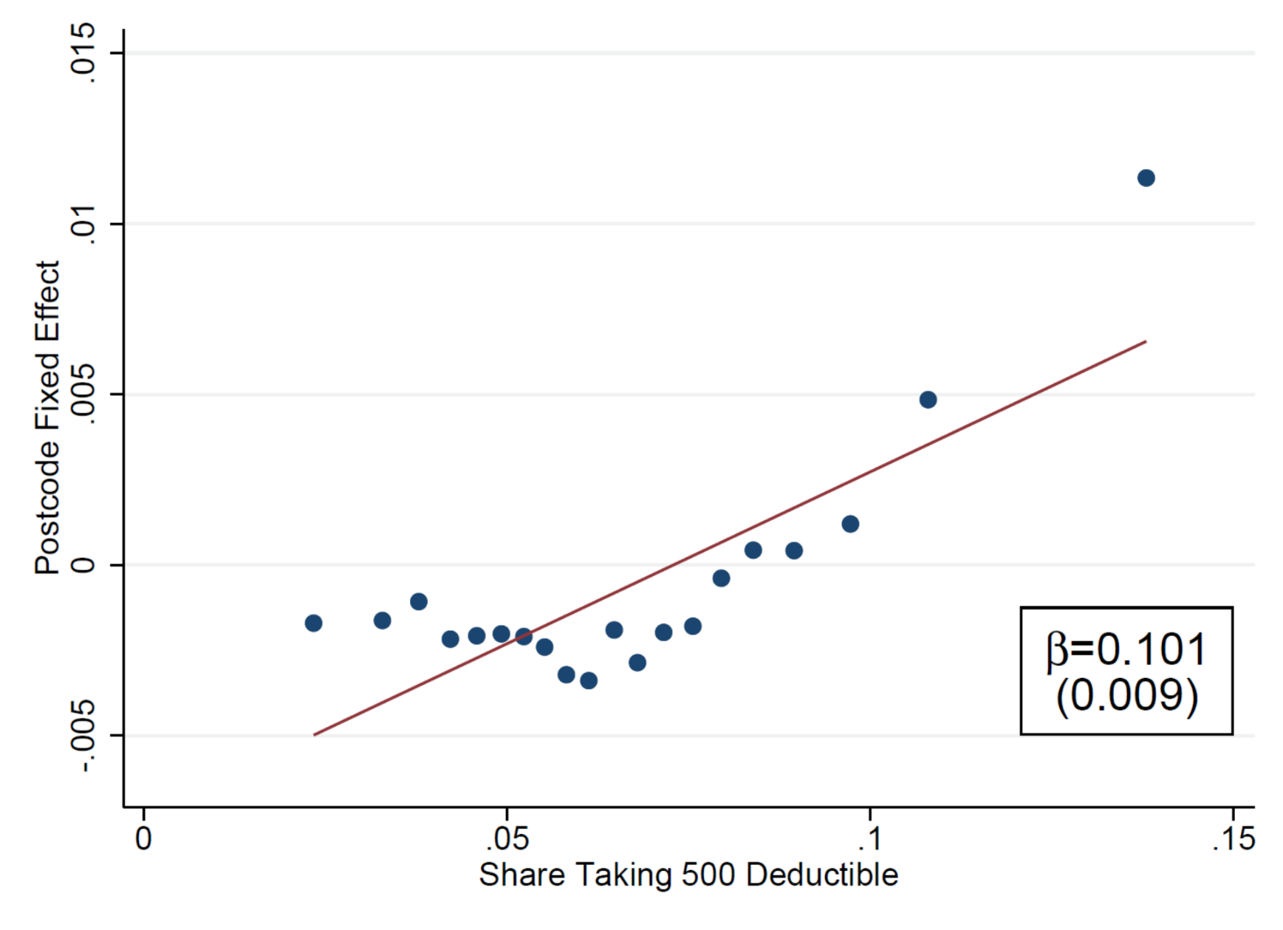
Peer Effects: Neighbors
Notes:
Last sentence is not correct anymore

Slide 46
Peer Effects: Splitting by Health
Notes:
Last sentence is not correct anymore

Slide 47
Consumer Welfare
Tremendous variation in deductible choices, conditional on risk, related to socio-economic and environmental factors
Implausible that this is driven by standard preferences. Much more likely that it is driven by information or choice frictions.
Calculate foregone consumer welfare:
  Corresponds to money-left-on-the-table for risk-neutral preferences
  Use predicted choice, given charact’s/environment and predicted health
Two cases:
  All else equal: Calculation conditional on Xs given population health risk distribution
  Health-SES Correlations: Calculation conditional on Xs given actual health risk distribution

Slide 48
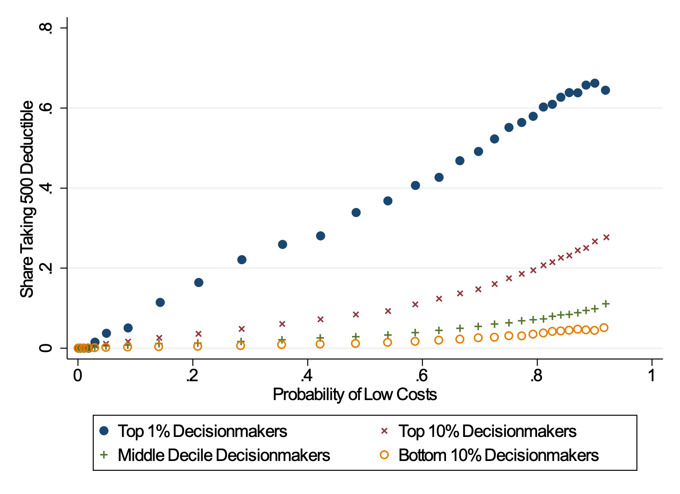
Deductible Choice and Health, by Choice Quality

Slide 49
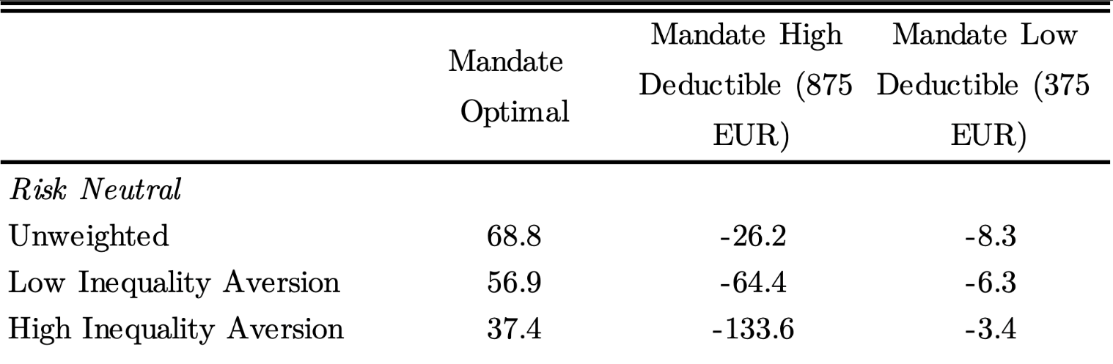
Counterfactual I: Allocate Optimal Deductible
Relative to status quo, optimal allocation policy improves consumer surplus by 68.8€ per consumer
This corresponds to 42% of € at stake!
Inequality aversion wrt income reduces welfare gain:
  low income / sick are positively correlated
  most sick stick with low deductible in status quo
Notes:
Check that all numbers here are correct. Seem to have changed a little bit, writing in paper different than tables by a little bit.
AT SAME TIME: Do this removing all people who are super marginal, where no policy / allocation we’re studying has a benefit or cost.

Slide 50
Counterfactual II: Mandate High Deductible
When there is a mandate that everyone have the high deductible, this:
    Slightly reduces consumer welfare with no inequality aversion
    Reduces consumer welfare by a lot under high inequality aversion
Poor / sick people who had been defaulted into low deductible and stayed there would lose by a lot
Notes:
Check that all numbers here are correct. Seem to have changed a little bit, writing in paper different than tables by a little bit.
AT SAME TIME: Do this removing all people who are super marginal, where no policy / allocation we’re studying has a benefit or cost.

Slide 51
Counterfactual III: Mandate Low Deductible
When there is a mandate that everyone have the low deductible:
    Minimal impact on consumer well-being
    90% stick with default, including those who should and those who shouldn’t
Value of currently offered deductible choice is limited
High-income people gain twice from deductible option:
    Make better decisions, conditional on health.
    In better health on average, so more to gain from deductible option.
Notes:
Check that all numbers here are correct. Seem to have changed a little bit, writing in paper different than tables by a little bit.
AT SAME TIME: Do this removing all people who are super marginal, where no policy / allocation we’re studying has a benefit or cost.

Slide 52
Structural Choice Model
Have run simulations with following consumer choice features:
Risk aversion
Switching costs
Rational Inattention
Active choice mistakes (e.g. imperfect information, high computational costs)
Random attention / Random mistakes
Loss aversion

Slide 53
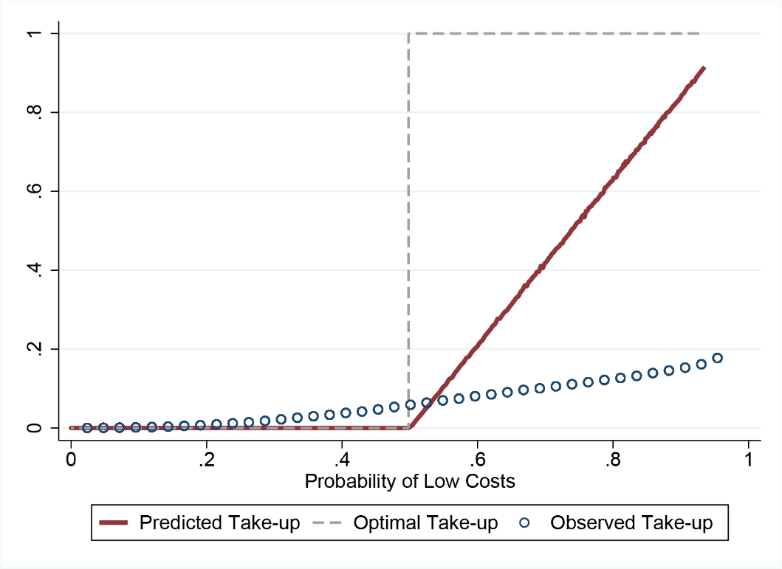
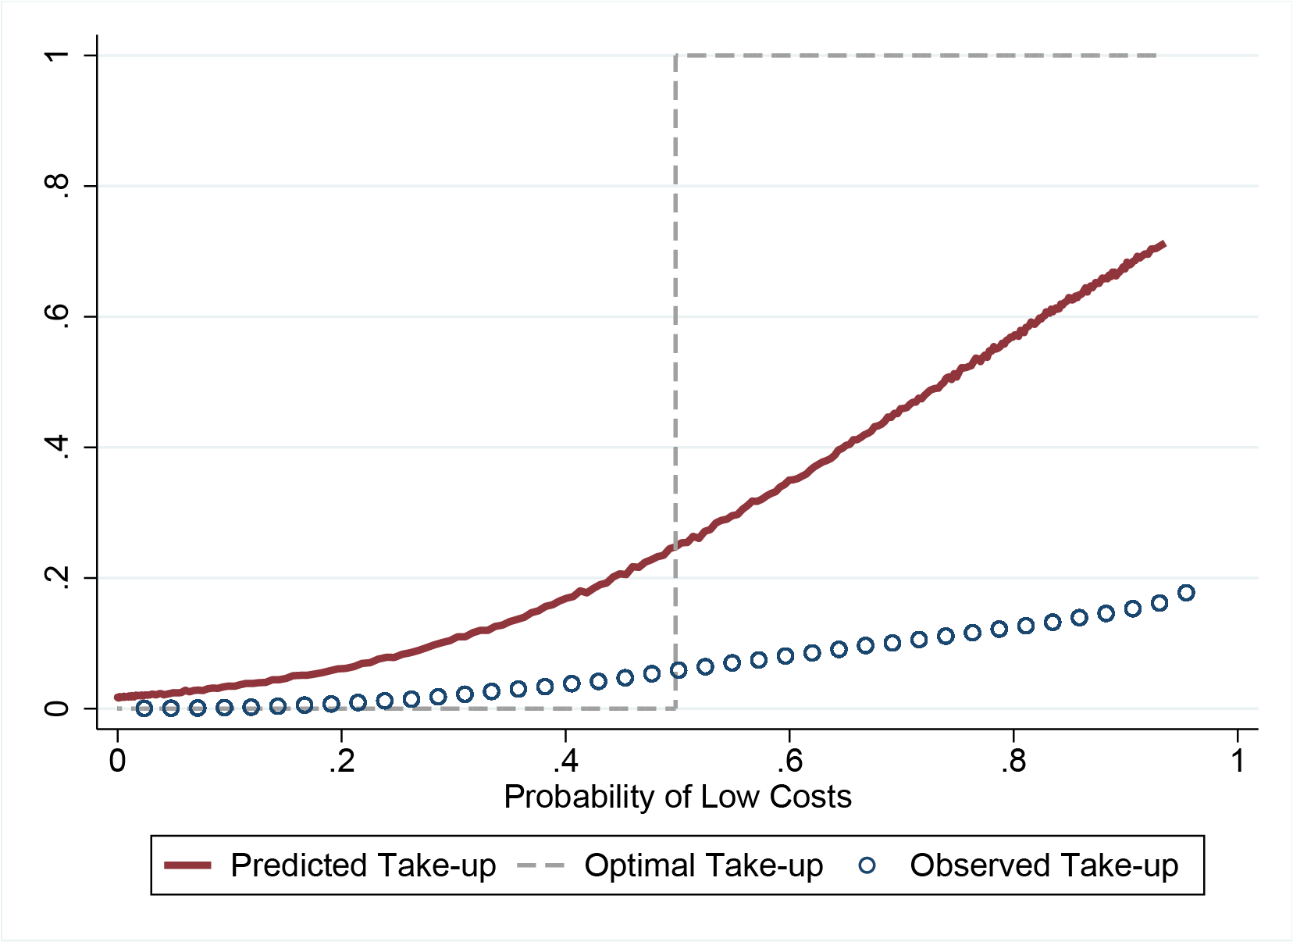
Low Switching Costs, Imperfect Info
A. Heterogeneous Switching Costs (mean 119 EUR)
B. Het. Switching Costs + Imperfect Info

Slide 54
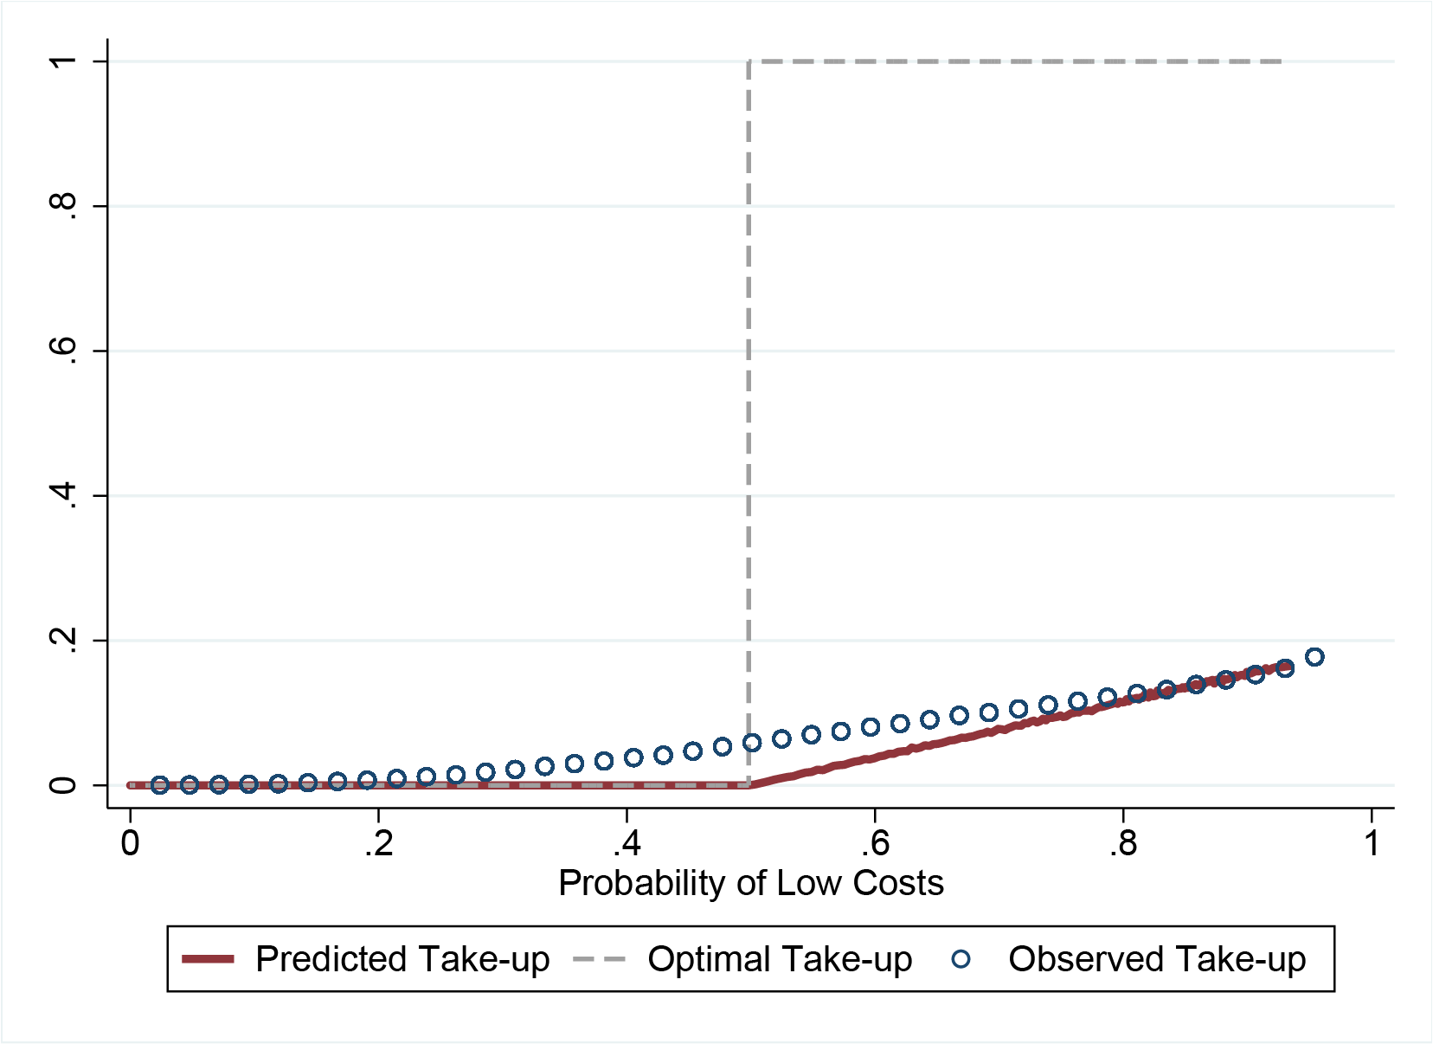
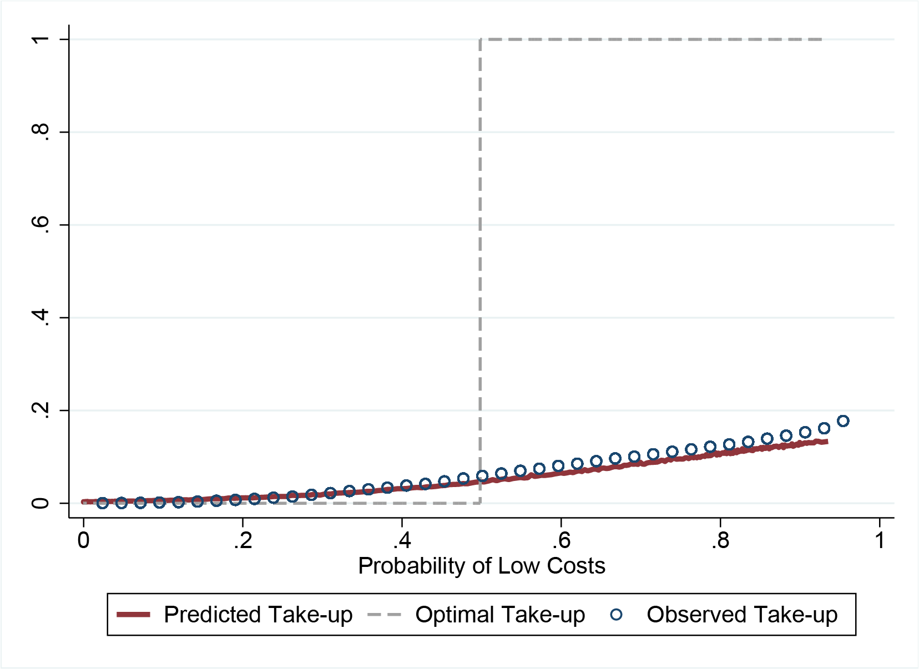
High Switching Costs, Imperfect Info
A. Heterogeneous Switching Costs (mean 650 EUR)
B. Het. Switching Costs + Imperfect Info

Slide 55
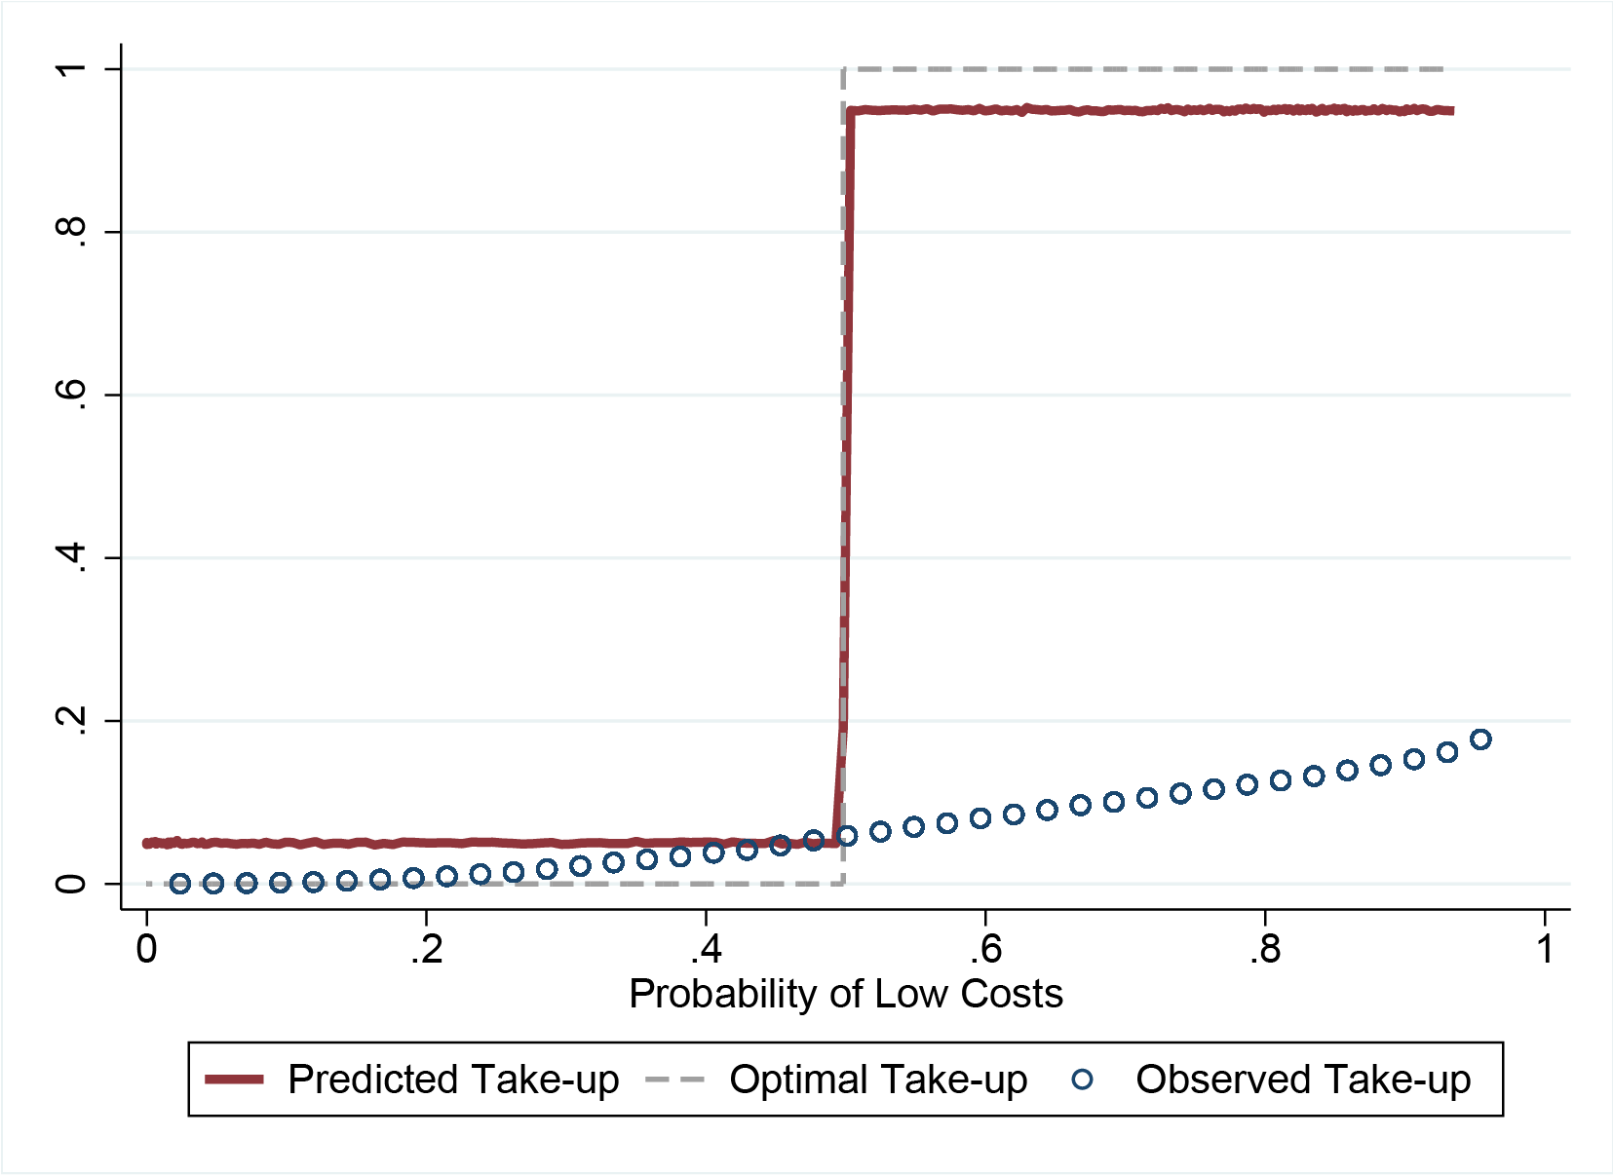
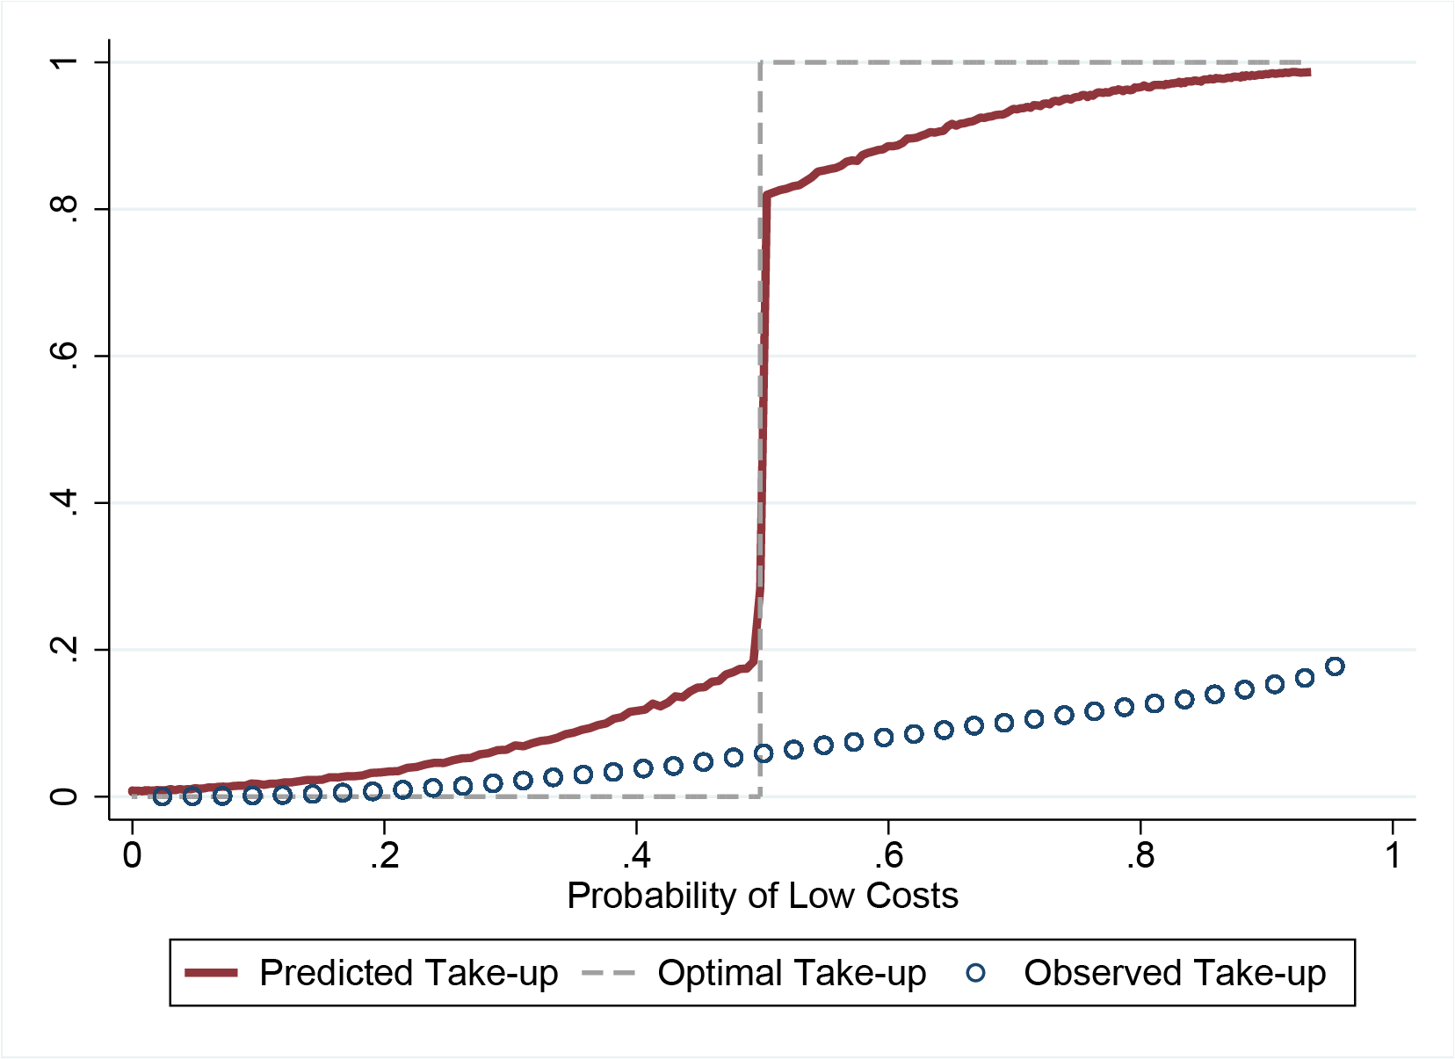
Mistakes and Rational Inattention
A. Mistakes (10%)
B. Rational Inattention

Slide 56
Wrap Up
Study entire population of the Netherlands using rich admin data
  Simple but informative choice: selecting deductible
  Average choice quality is low in the population
Significant heterogeneity by social factors
  Important role for education, exposure to peers, and insurer effects
Behavior consistent with choices being difficult and potentially costly to enrollees
  Choices are systematically worse for lower income/SES
  Choice-based policy can exacerbate inequality

Slide 57
Details: Health Insurance in the Netherlands
Managed Competition with regulated choice
  Regulator determines standard health insurance plan
  Private insurers compete on price, network and supplements (dental, physical therapy)
  No price discrimination. Standard plan costs €1133 on average
Standardized deductible choice
  Compulsory deductible of €375 applies to annual expenditures (excluding GP and maternal care)
  Voluntary deductible choice of €100-increments up to €500
  Average price reduction of €50 per €100 increment
All adults pick health plan at end of the year
Premium discounts
Take-up over Time

Slide 58
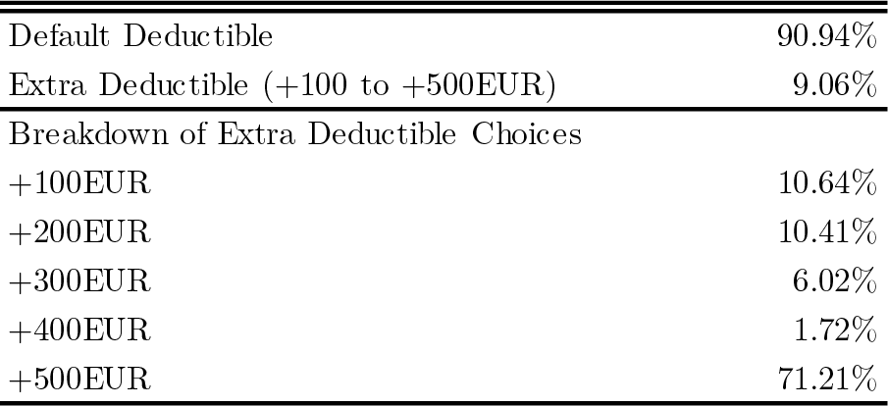
Deductible Choice
Table 1: Distribution of Deductible Choices
Most people in population stick with default option.
Notes:
These are the numbers for 2015

Slide 59
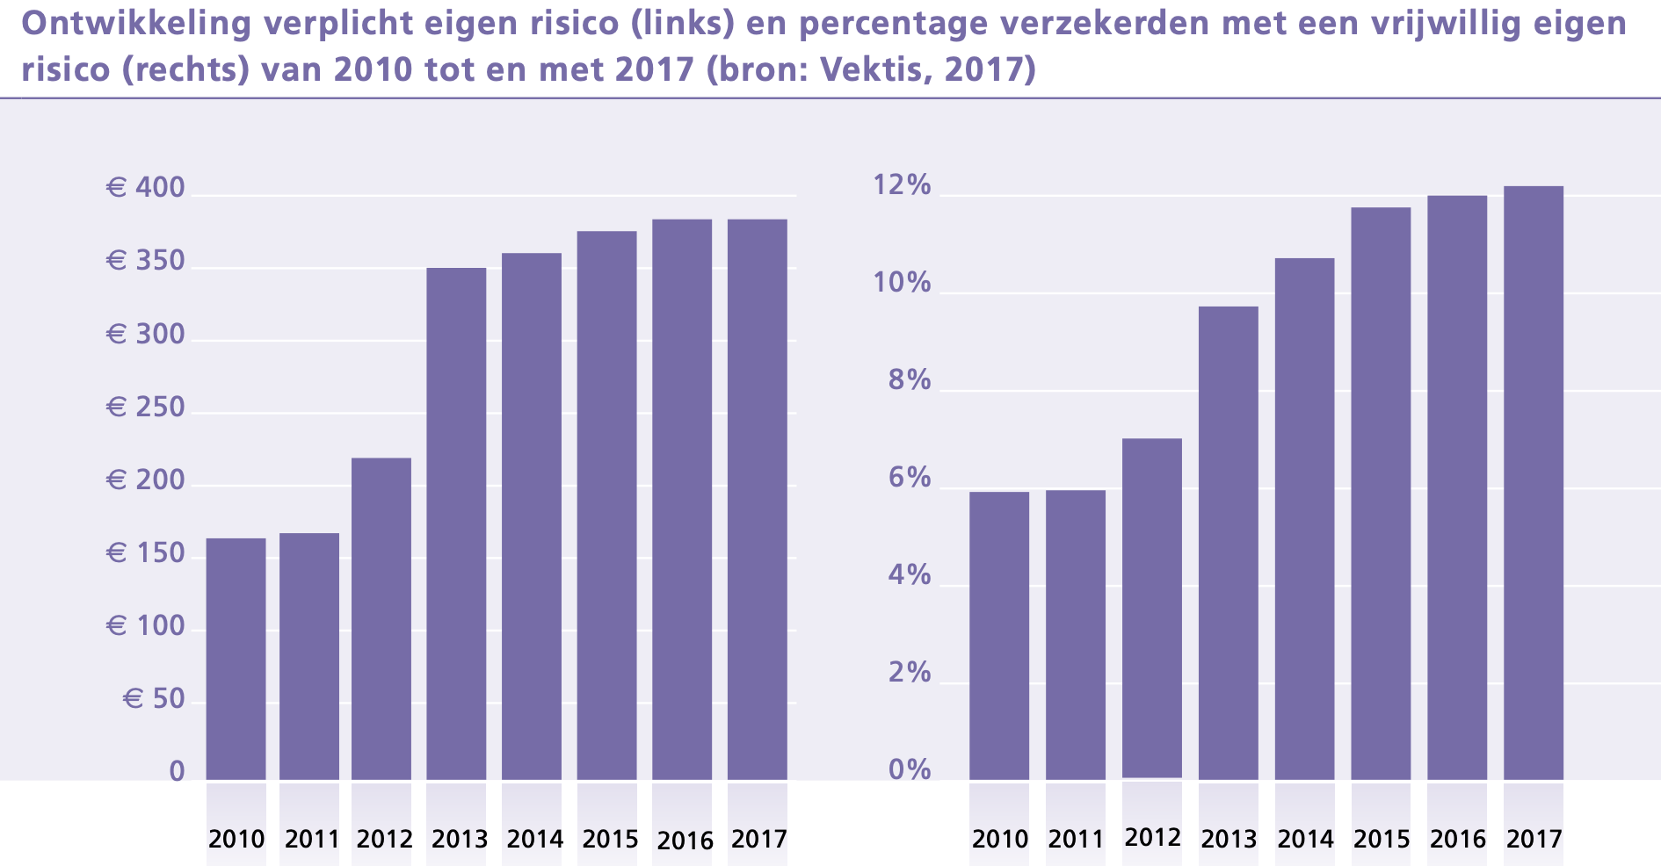
Evolution of Mandatory Deductible and Take-Up
Back

Slide 60
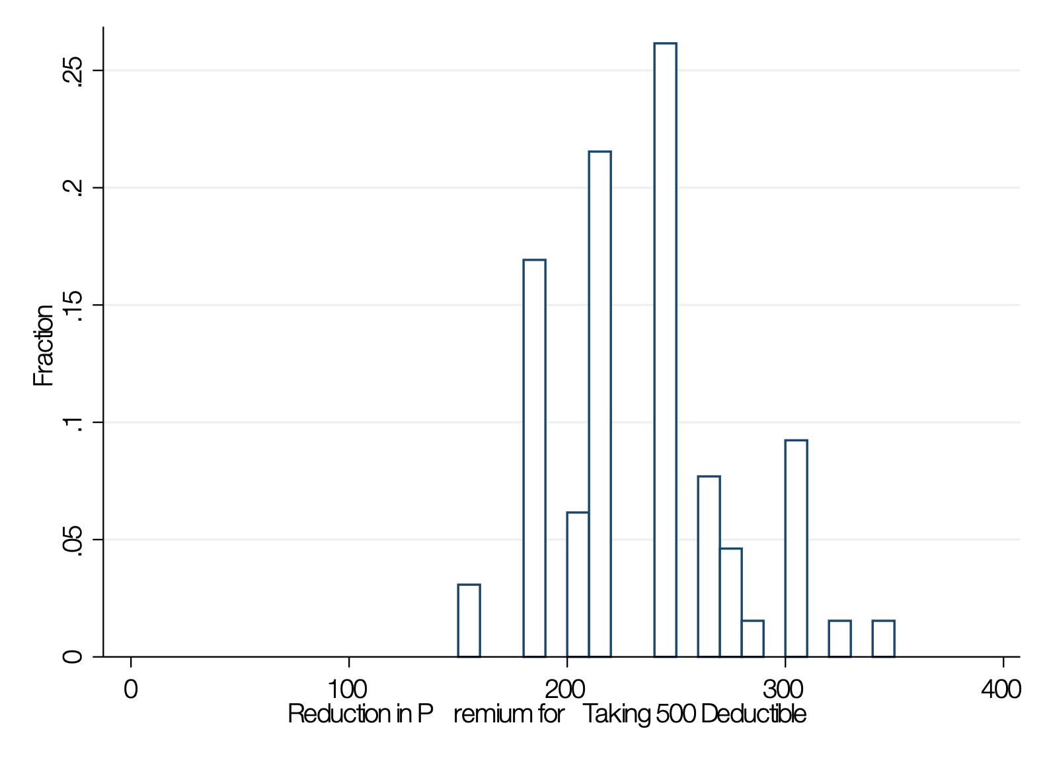
Distribution of Premium Reductions
Reduction in Premium for Taking 500 Deductible
Back

Slide 61
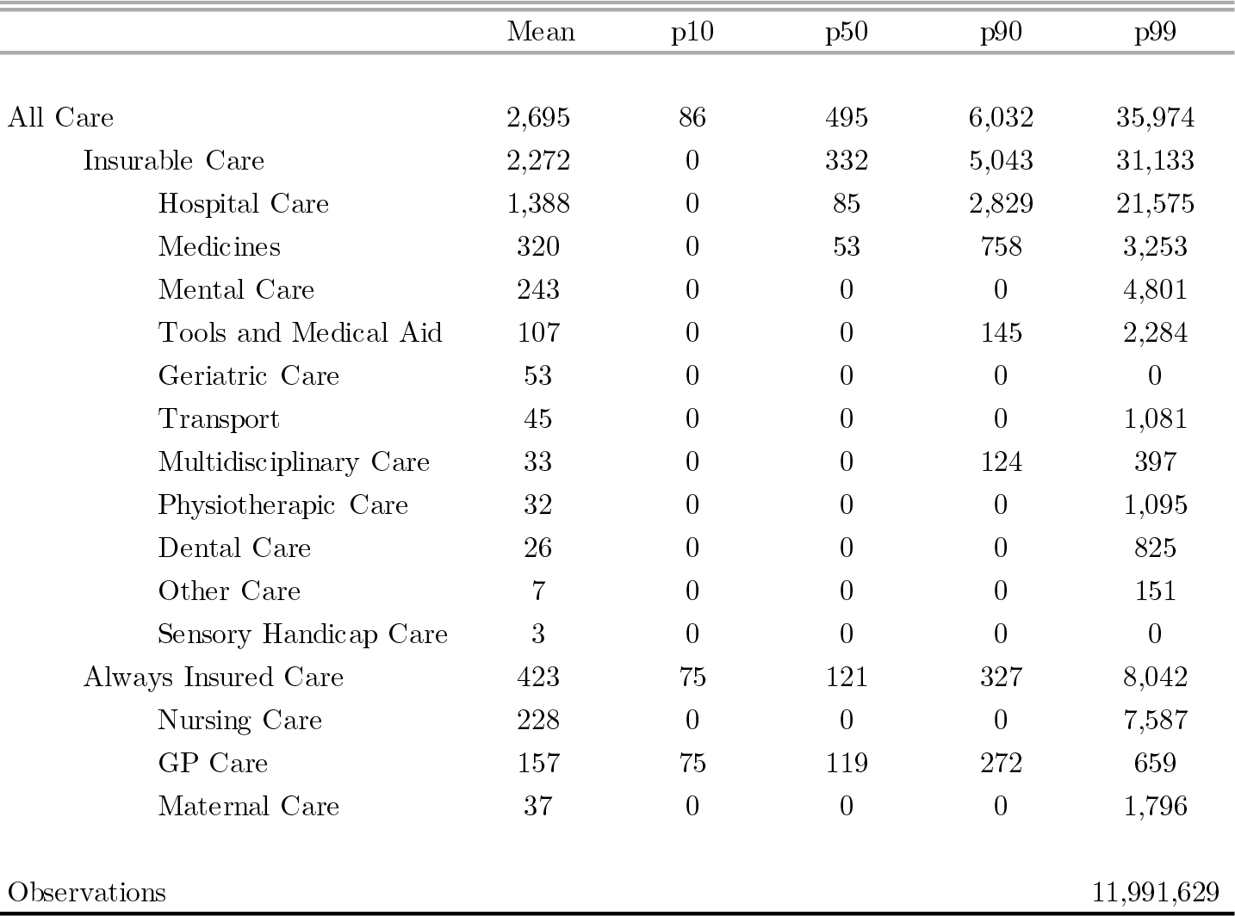
Distribution of Health Costs, by Category
Back

Slide 62
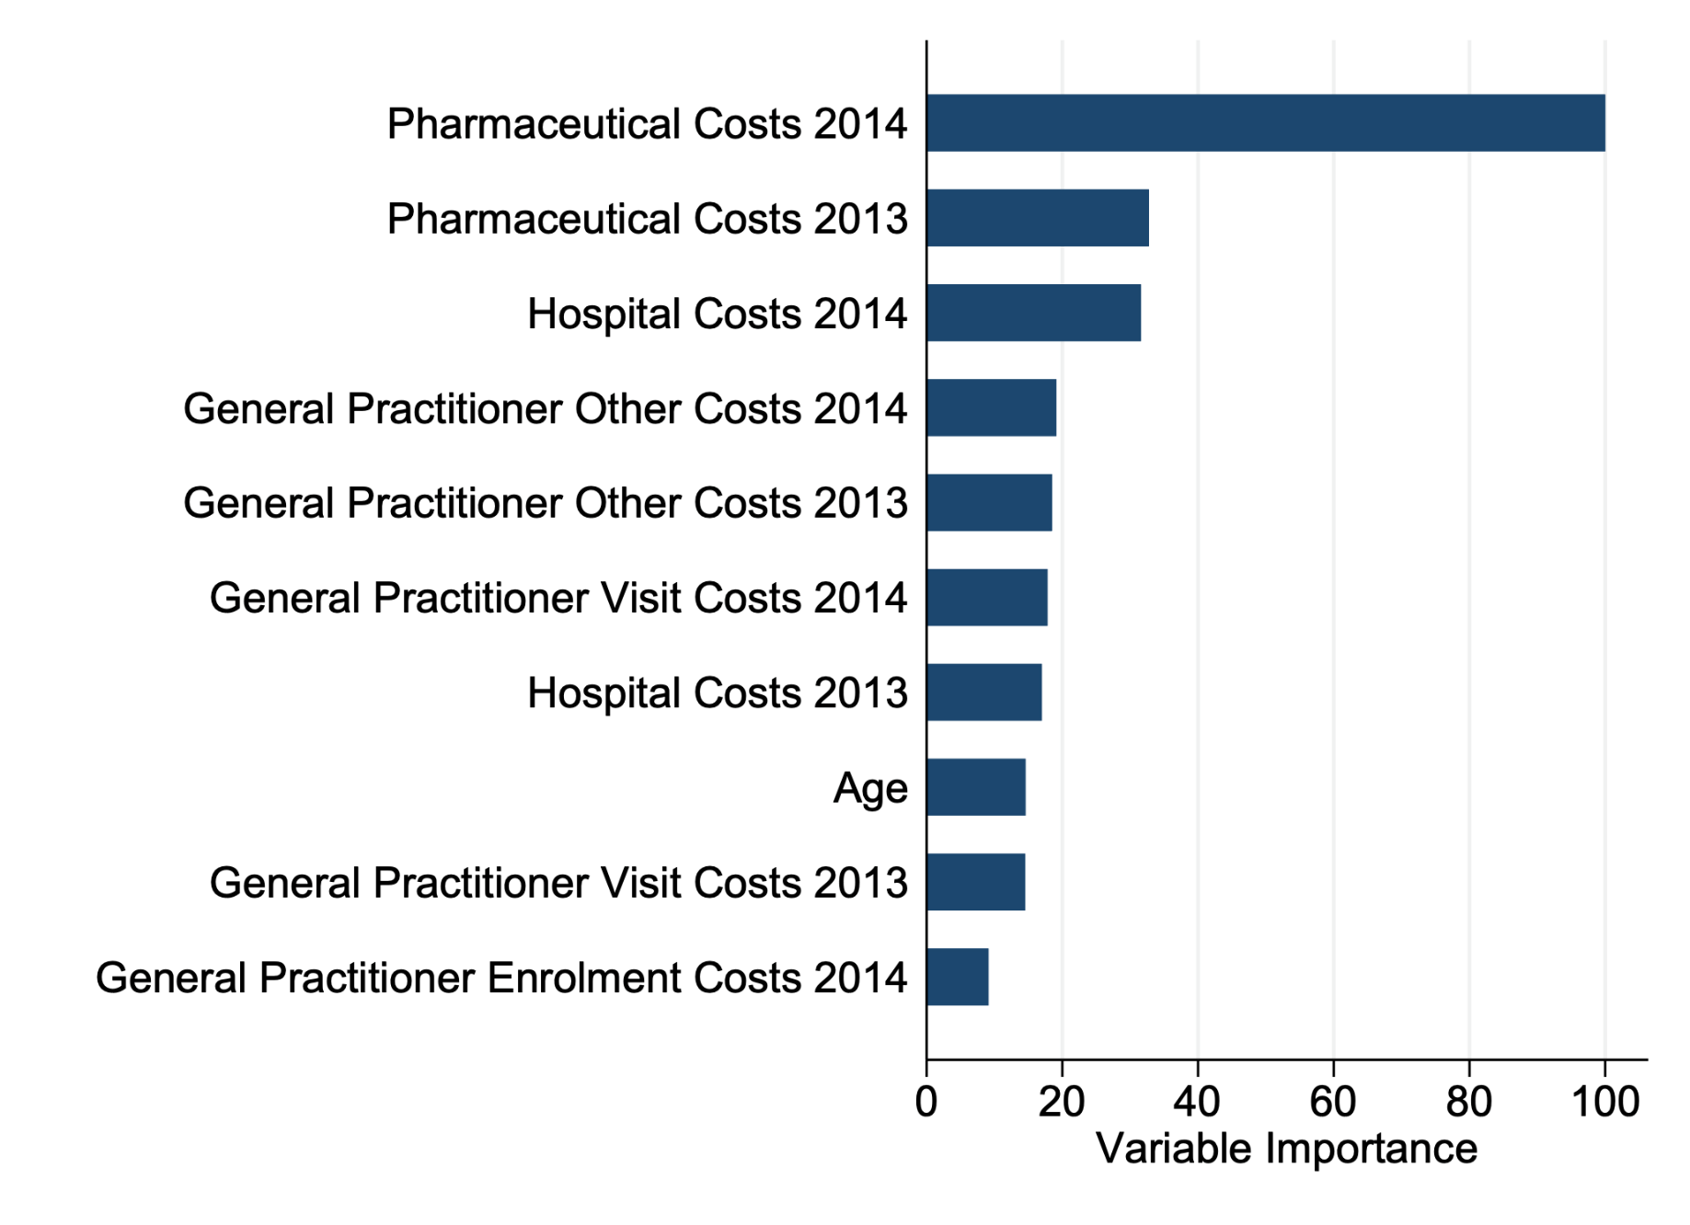
Variable Importance in Prediction with Random Forest
Back

Slide 63
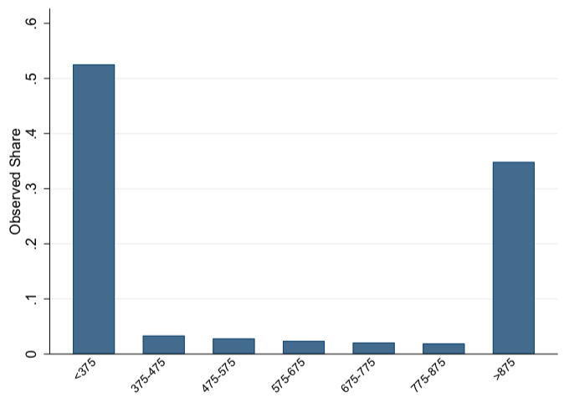
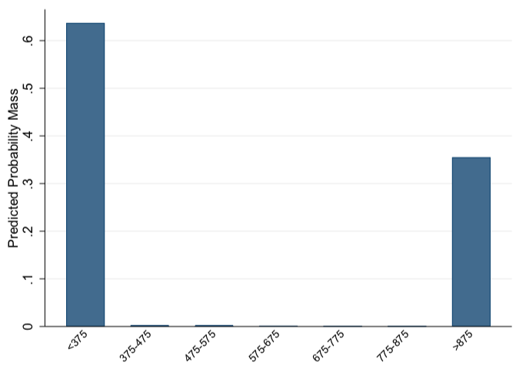
Multiclass Classification
Observed shares in deductible bins
Predicted shares in deductible bins

Slide 64
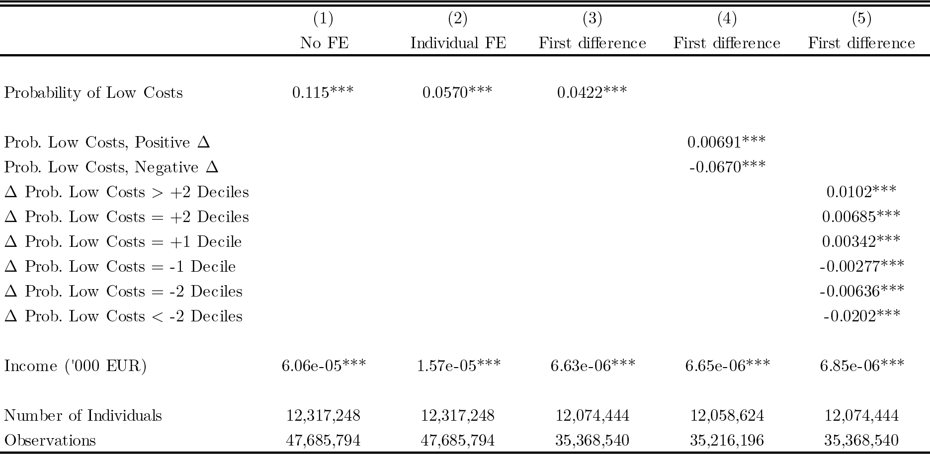
Variation Across vs. Within Individuals
Insert New Table with Income and Health

Slide 65
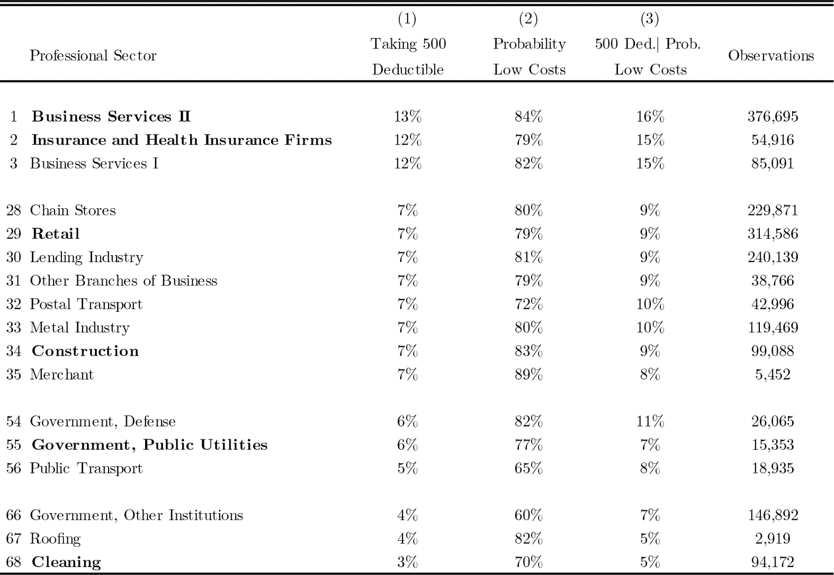
Notes:
In total there are about 100 degree types

Slide 66
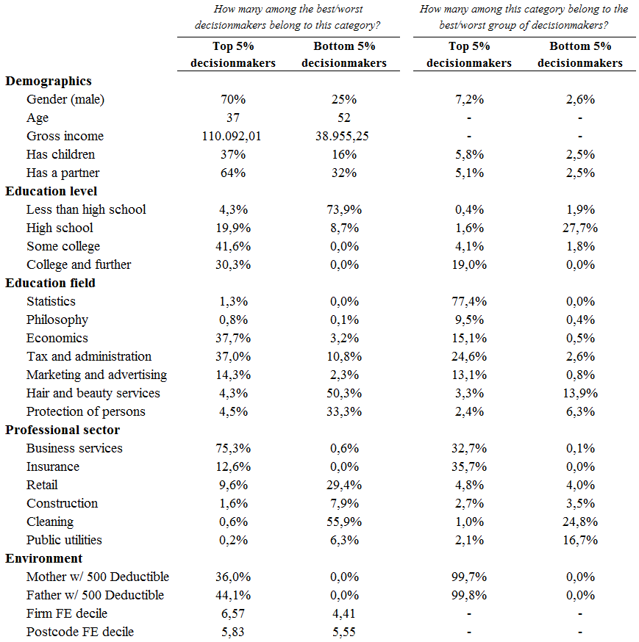
Table of Best vs. Worst Decisionmakers
Back

Slide 67
Extra: Parent Effects

Slide 68
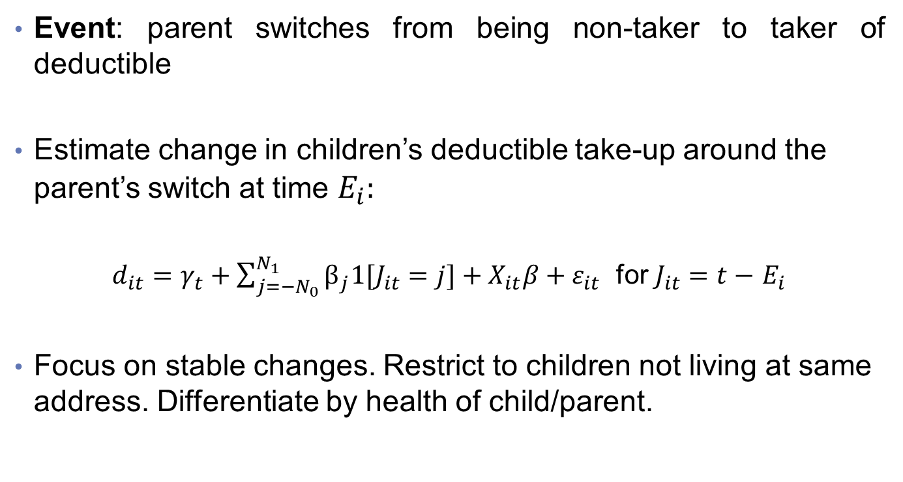
Peer Effects: Event-Study Design
Event: parent switches from being non-taker to taker of deductible
Estimate change in children’s deductible take-up around the parent’s switch at time $E_{i}:$
$d_{it}=γ_{t}+\sum_{j=−N_{0}}^{N_{1}}{β_{j}1[J_{it}=j]}+X_{it}β+ε_{it}$ for $J_{it}=t−$ $E_{i}$
Focus on stable changes. Restrict to children not living at same address. Differentiate by health of child/parent.
Splitting by health status
Notes:
Note: this excludes all children who still live with their parents.
The event study is only estimated on the sample of individuals whose father switches into taking 500 deductible, so timing of father switching identifies the \tau.
Remember: unbalanced panel. In event study regression, no individual FE, but controls for health risk (10 deciles), gender, FE age, FE year, FE education level and education field.
The less restricted event study with 2 years before and after looks similar.

Slide 69
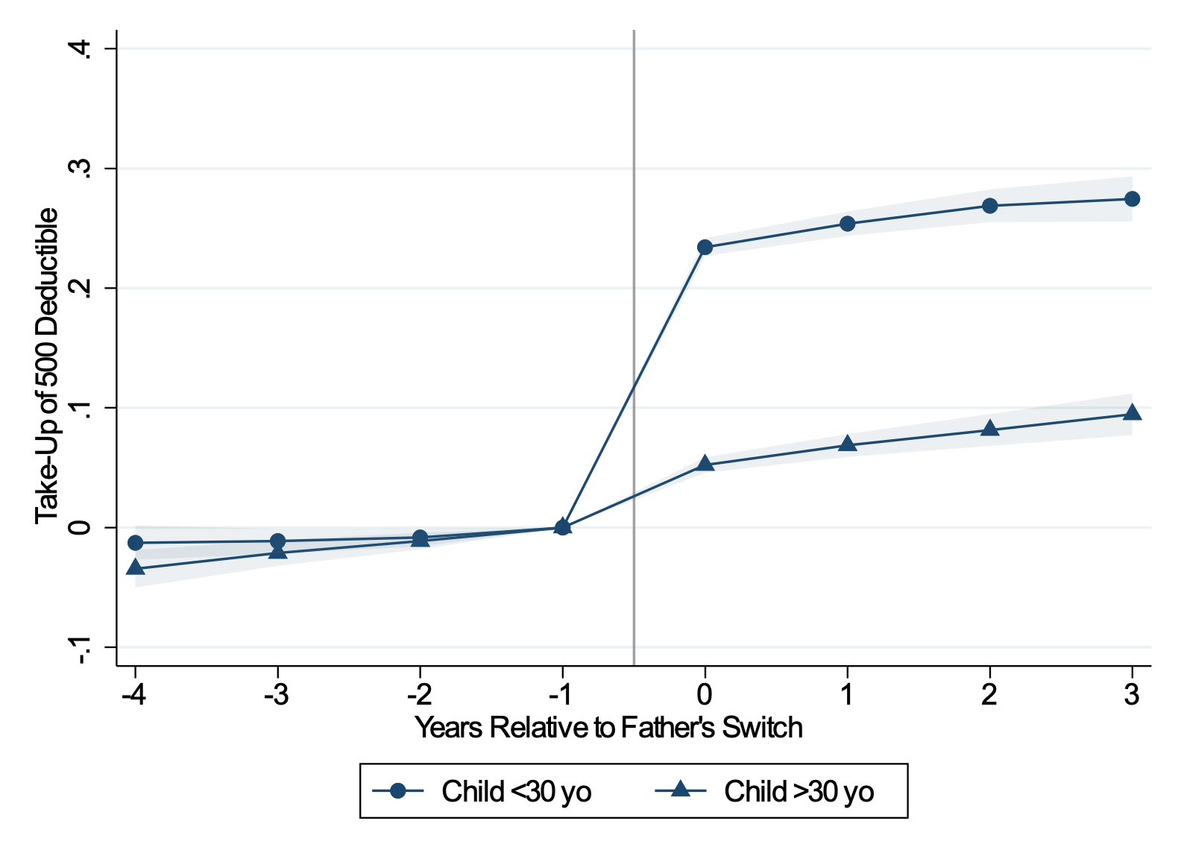
Peer Effects: Parents
Notes:
Last sentence is not correct anymore… as with continuous probabilities and OLS these intercepts are not interpretable anymore as “ regardless of health”

Slide 70
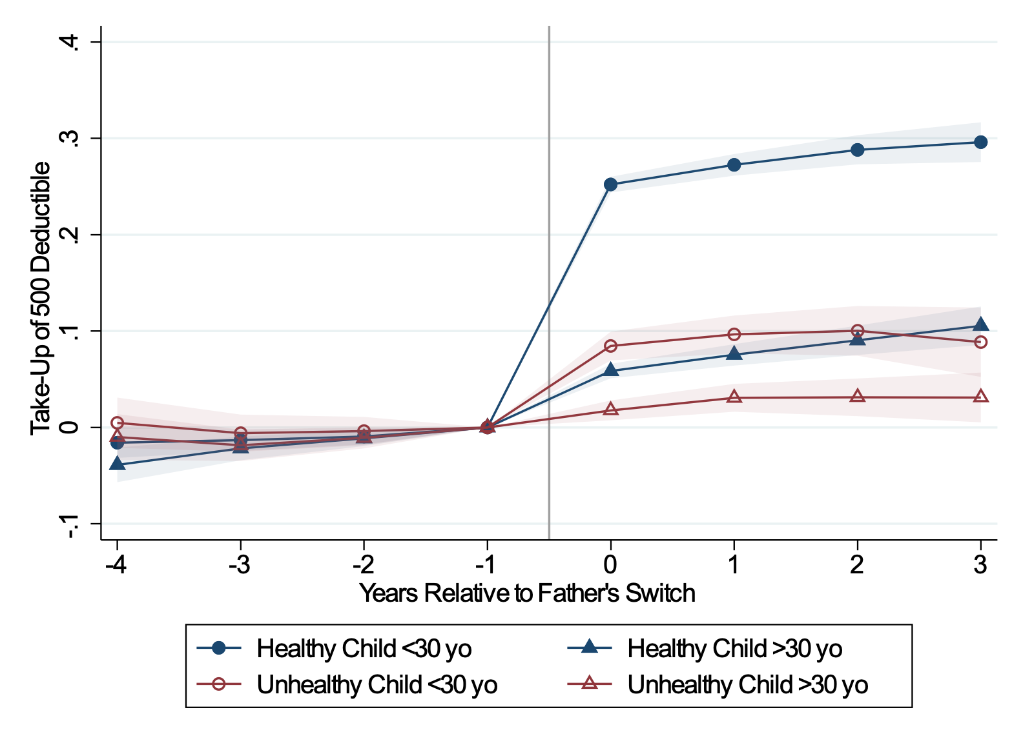
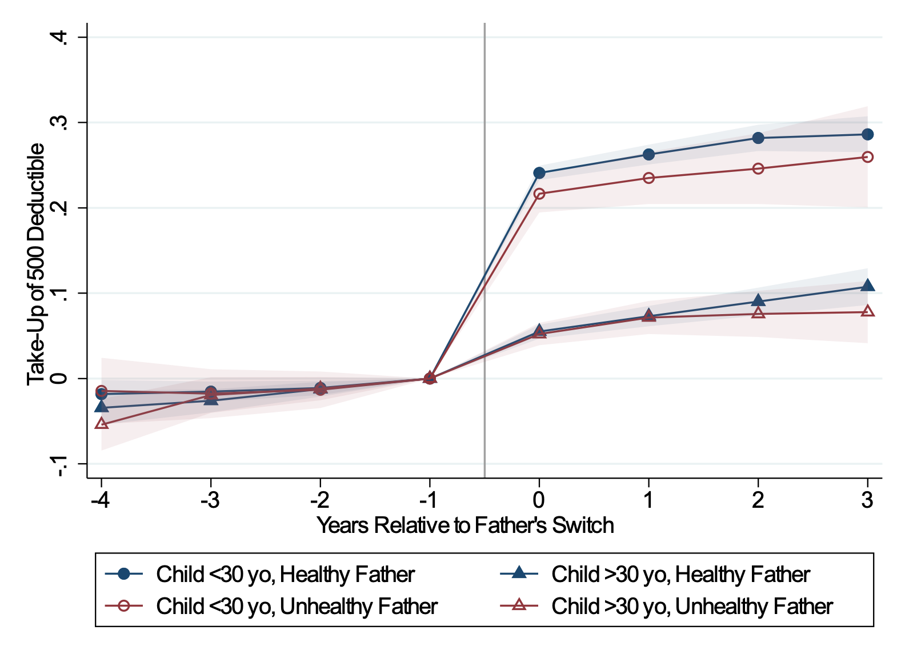
Peer Effects by Health Child / Parent
Notes:
Last sentence is not correct anymore… as with continuous probabilities and OLS these intercepts are not interpretable anymore as “ regardless of health”

Slide 71

Peer Effects and Deductible Take Up I: Colleagues
Firms
Notes:
Last sentence is not correct anymore.

Slide 72

Peer Effects and Deductible Take Up II: Neighbors
Postcodes
Notes:
Last sentence is not correct anymore

Slide 73

Peer Effects: Robustness
Notes:
Last sentence is not correct anymore

Slide 74
Extra: Insurer Effects

Slide 75
Insurer Effects: Price and Choice Architecture
Individuals choose among 20 insurers who differ in premium reductions and display features on websites
Prior regressions were controlling for insurers FEs.
Use FEs to get causal effects a la AKM:
  Estimated coefficient equals .65 (relative to .14 and .10 for fims and location)
  Substantial dispersion in take-up rates and relation to predicted health
Link FEs to price and display features.

Slide 76

Peer Effects and Deductible Take Up IV: Insurers

Slide 77
Peer Effects and Deductible Take Up IV: Insurers

Slide 78

Insurer Effects: Price vs. Display Features
Regressing Insurer Fixed Effects on Insurers Website Characteristics

Slide 79
Lessons and Thinking Ahead (cont’d)
Our prediction algorithm can generate tremendous value in offering choice:
  Choice aids - provide individual-specific information through insurers or through NZa
  Smart defaults – assign individuals to cost-minimizing option
  We have implemented data-based choice aids before (see Ben and Jon’s prior work)
A lot can be learned from experimentation:
  Large-scale field experiments are ideal (see my own prior work with Belgian tax administration)
  Lab experiments and surveys – when linked to admin data – can be very valuable too

