Slide 1
Competition and choice in the UK National Health System
Carol Propper
Imperial College Business School

Slide 2
Some stats on the NHS
Health Expenditure per capita (OECD, 2018)

Slide 3
Some more stats
Healthcare free at point of demand + tax financed
Total budget £129bn 2018/19; c10% GDP
Activity driven by global budget
In 2000-2010 health spending in England increased 6.6% pa in real terms; 2010-19 1.3%.
Activity growth 4.8% pa in first decade, 2.7% in the second
Major shift towards hospital care
Family doc consultations increased by 0.7% pa, planned (elective in hospital care) by 9.6%
Large increase in use of non-NHS care (mainly hospital services) from a low base
2000-2019 11.3% annual growth compared to 3.8% for NHS hospital and community health services

Slide 4
Broad NHS organisation
Providers
Secondary and tertiary services mainly provided by public hospitals with increasing private hospitals provision for mainly elective services paid for by NHS contracts
Primary care provided by family doctors
Patients have some choice of hospital and some choice of GP; increased since 2000
Purchasers/insurers
Local admin/geog area based purchasing; patients have no choice of purchaser

Slide 5
Experiments in (non-price) competition
Two large experiments in promoting supply side competition
1991-97: separation of insurers and hospital providers + selective contracting on price, volume (price competition)
1997-2003: abolition of competition
2006: Blair pro-competition policies
Key elements
Freedom for patients to choose hospital of care
Shift from selective contracting to administered prospective prices –(c. 65% hospital activity), not strongly related to quality
Greater autonomy for well performing hospitals (retain some surpluses; greater freedom over investment decisions)
Greater use of private provision to expand publicly funded provision

Slide 6
What happened?
Did the reforms change behavior and market structure?
Did this have any effect on outcomes, processes, productivity, equity?
Which reform components were important?

Slide 7
(1) Behaviour and market structure
Patient choice severely constrained pre-reform; exercised greater choice post-reform
Post-reform patients responded to quality (mortality rates) and distance
Bigger response for sicker patients; no difference by income
Reduction in market concentration
Significant impacts on hospitals’ market shares
Better hospitals attracted more patients post-reform

Slide 8
(2) The effect of the reforms
Increased volumes of hospital care
Larger role for private sector (didn’t reduce NHS provision)
Quality (most studied)
Mixture of positive effects or no effects
No evidence of negative effects
Some of these gains may have started before the reforms
Productivity
Less evidence
Length of stay fell in less concentrated markets post reform
No evidence of greater spending
Access/inequality
Little evidence of differential effects by SES (of small local area)
Waiting time gap between richer and poorer areas fell over the period of the policy but may have started pre-policy

Slide 9
Evidence from (earlier) UK Hospital consolidation
1997-2003 England experienced a wave of hospital reconfigurations
Over half of acute hospitals involved in a reconfiguration; median number of hospitals in a market fell from 7 to 5
Impact on hospital production
Lower growth in admissions and staff numbers but no increase in productivity
No reduction in deficits
No improvement in quality
Costly to bring about with few visible gains other than reduction in capacity

Slide 10
Summary: What do we know from the UK experiment?
Impact of reforms appears positive
Patients and hospitals appear to have responded
Better hospitals attract more patients
Quality rose without an increase in expenditure
Some of this might be due to increased managerial effort
Consolidation policy appears to have opposite effect

Slide 11
Where now?
Current policy – major shift from competition to integrated care (2019 NHS Plan)
Aim: Integrated Care Systems everywhere by April 2021
Defined at area level
“ICSs bring together local organisations in a pragmatic and practical way to deliver the ‘triple integration’ of primary and specialist care, physical and mental health services, and health with social care”
Retention of contracting arrangements with greater emphasis on quality and on purchasing bundles of care
The likely outcomes
Greater provider consolidation (encouraged by policy)
More integrated services? Or greater exercise of monopoly power by secondary care providers? How much patient choice?

Slide 12
THANK YOU

Slide 13
A few additional slides

Slide 14
Better hospitals attracted more patients (Gaynor et al)
Source: Gaynor et al Free to Choose
Notes:
14

Slide 15
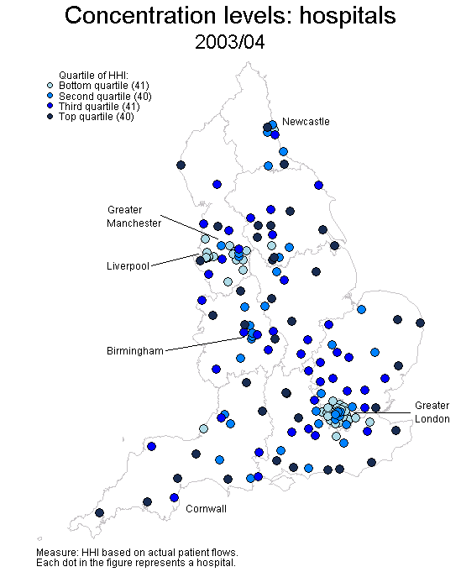
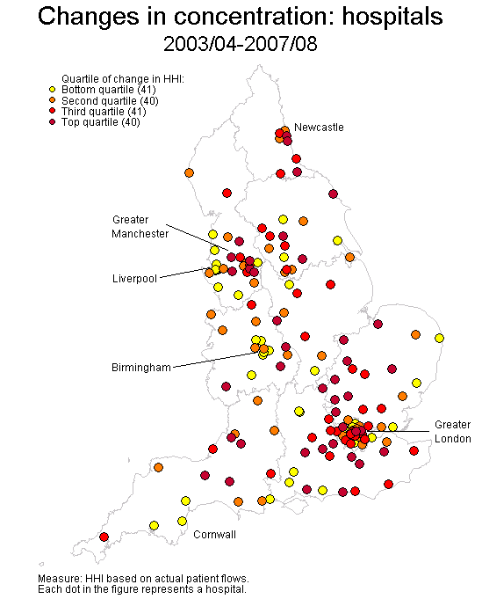
Where did freeing up choice have an impact?
Source: Gaynor, Morreno,-Serra, Propper

Slide 16
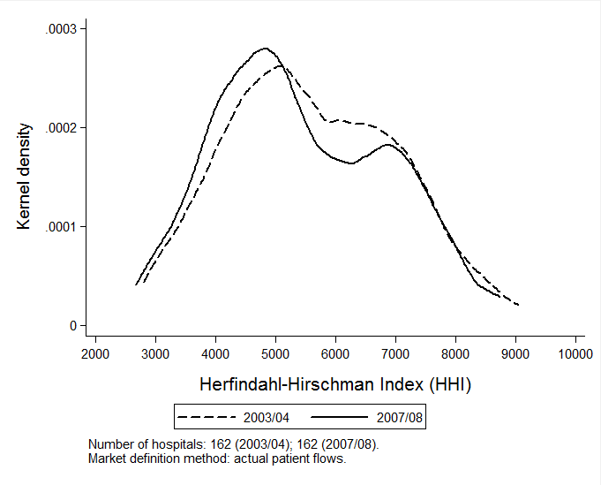
Change in market structure: provider HHI all electives

